Slide 1

Executing Code with Too Much Privilege
Modified by: Abraham J. Reines
CS531
Adapted from previous iterations
Credit to Carson Blythe

Slide 2
Objectives
• Understand the concept of privilege management and its role in system security.
• Learn the principles of Least Privilege and their impact on secure software design.
• Examine examples of privilege mismanagement and its consequences.
• Explore real-world scenarios where privilege misuse led to security vulnerabilities.
• Identify best practices for reducing excessive privilege risks in software development.

Slide 3
Introduction to Privilege Management
• Privilege management is the control of access levels within a system.
• Privileges define the actions users and processes can perform on resources.
• Proper management of privileges is essential for maintaining security boundaries.
• Mismanagement can lead to unauthorized access and potential system compromise.

Slide 4
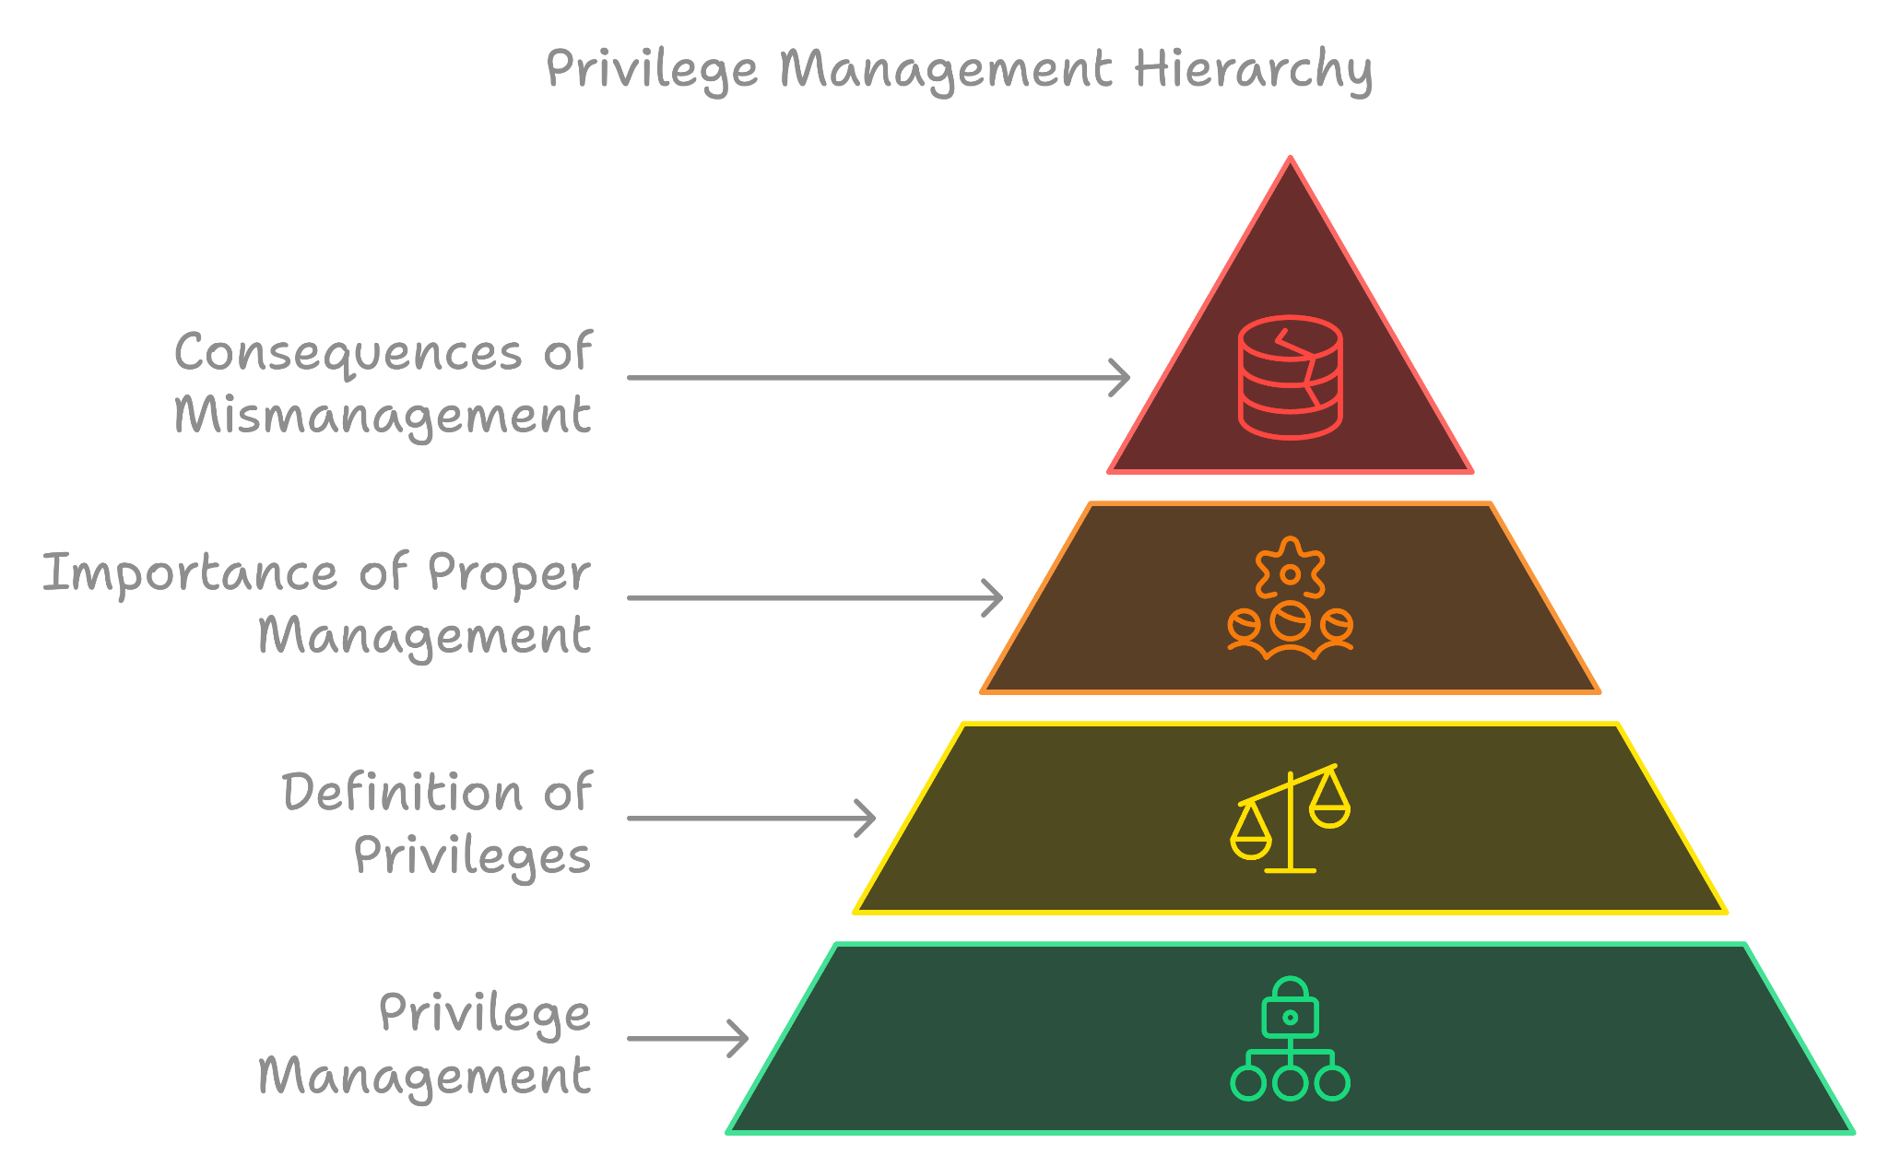
Privilege Management

Slide 5
Overview of Least Privilege Principle
• The Principle of Least Privilege (PoLP) ensures users and applications operate with the minimal set of permissions necessary.
• Reduces the attack surface by limiting potential damage in the event of a breach.
• Originated in 1975 by Saltzer and Schroeder in their seminal paper on security.
• Applied in all modern operating systems, from Windows to Linux and macOS.

Slide 6
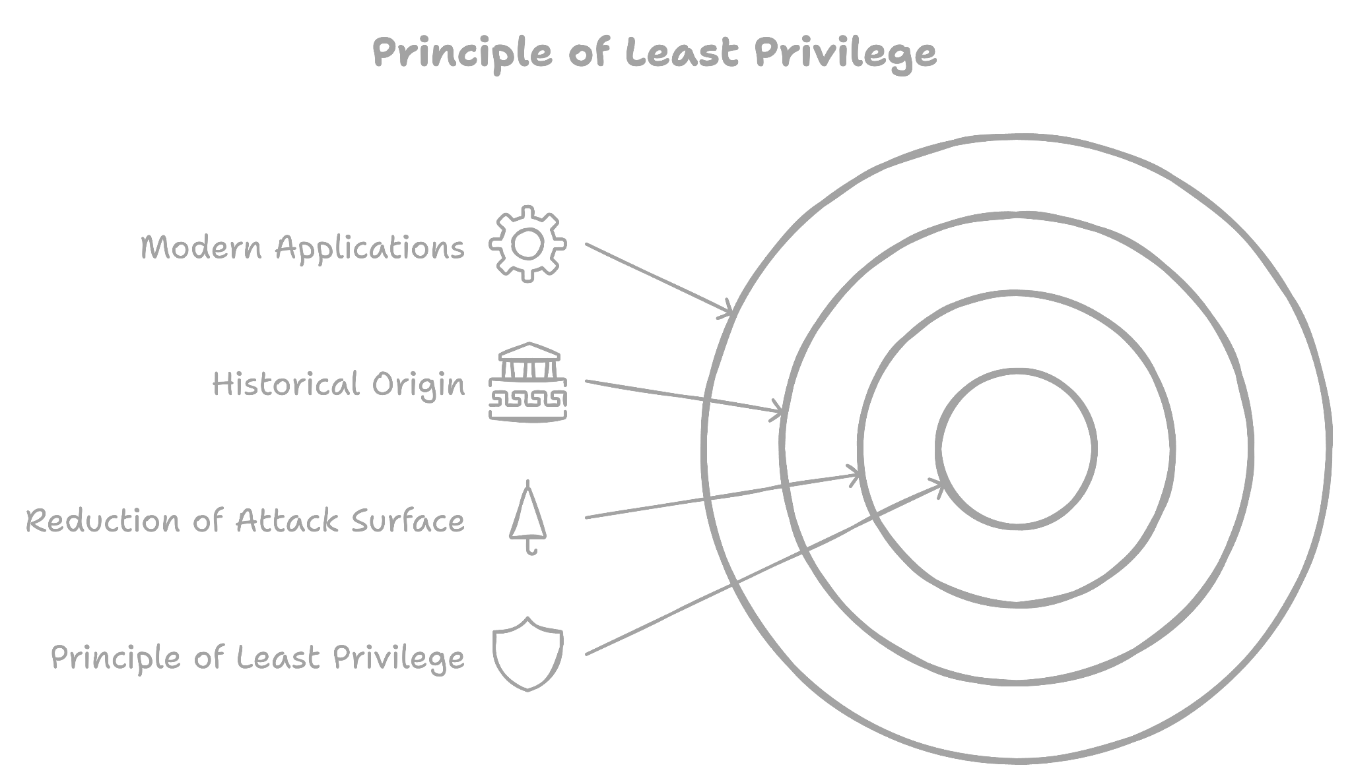
Least privilege Principle

Slide 7
Historical Context of Privilege Management
• In 1975, Saltzer and Schroeder introduced the Least Privilege concept in “The Protection of Information in Computer Systems.”
• Early systems, like Unix, were designed with simple privilege models based on root and user roles.
• The evolution of modern operating systems (e.g., Windows Vista) incorporated more sophisticated privilege management, such as User Access Control (UAC).
• Today, least privilege principles are fundamental in mitigating vulnerabilities across diverse platforms.

Slide 8
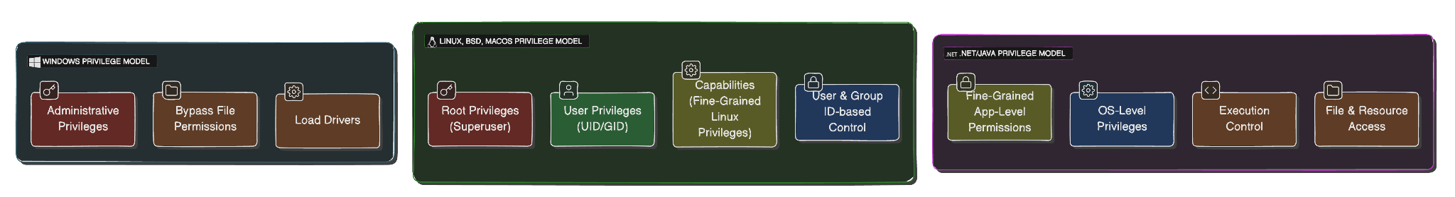
Privilege Models in Different OS Environment
• Windows Privileges: In Windows, privileges are specific actions a user can perform. For example, bypassing file permissions.
• Administrative Privileges: Provide complete control over system functions.
• User Privileges: More limited, prevent access to critical system configurations.
• Linux, BSD, and macOS Privileges: Rely on user ID (UID) and group ID (GID) for privilege management.
• Root Privilege: The superuser account with unrestricted access to system.
• Capabilities (Linux): Introduces fine-grained privileges, allowing processes to run with only the necessary permissions.
• .NET and Java: Add another layer of privilege management through fine-grained, application-level permissions which sit on top of OS privileges.
Summary: Each OS handles privileges differently, but the key challenges remain the same: minimal necessary permissions are applied to reduce security risks.

Slide 9
The Sin Explained: Executing Code with Too Much Privilege
• The Sin: Running code with excessive privileges which allow attackers to exploit vulnerabilities.
• Why It’s Dangerous: If malicious code is executed, it runs with the same privileges as the compromised process.
• Common Scenarios:
• Applications running as root on Linux unnecessarily.
• Windows services running with administrator privileges when not required.
• Design Issue: Poor designs from developers grant excessive permissions to avoid security errors in functionality.
Summary: The sin of excessive privileges magnifies the impact of any security vulnerabilities, making the system more susceptible to calamitous breaches.

Slide 10
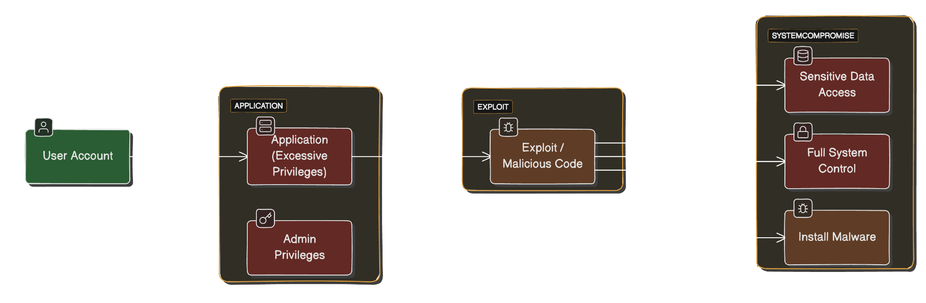
The Sin Explained: Executing Code with Too Much Privilege

Slide 11
Real-Life Example: Windows Media Player
• Scenario: Windows Media Player running with administrative privileges.
• If an attacker exploits a vulnerability in the player, their malicious code executes with administrative rights, giving them full control over the system!
• Impact: This type of vulnerability allows attackers to:
• Install malware.
• Manipulate system files.
• Control system configurations.
• Lesson: Applications like media players should never need administrative privileges for normal operations. Running them with these privileges creates unnecessary risks.
Summary: Real-world examples like Windows Media Player show how running non-essential services with administrative privileges can expose the system to severe security breaches.

Slide 12
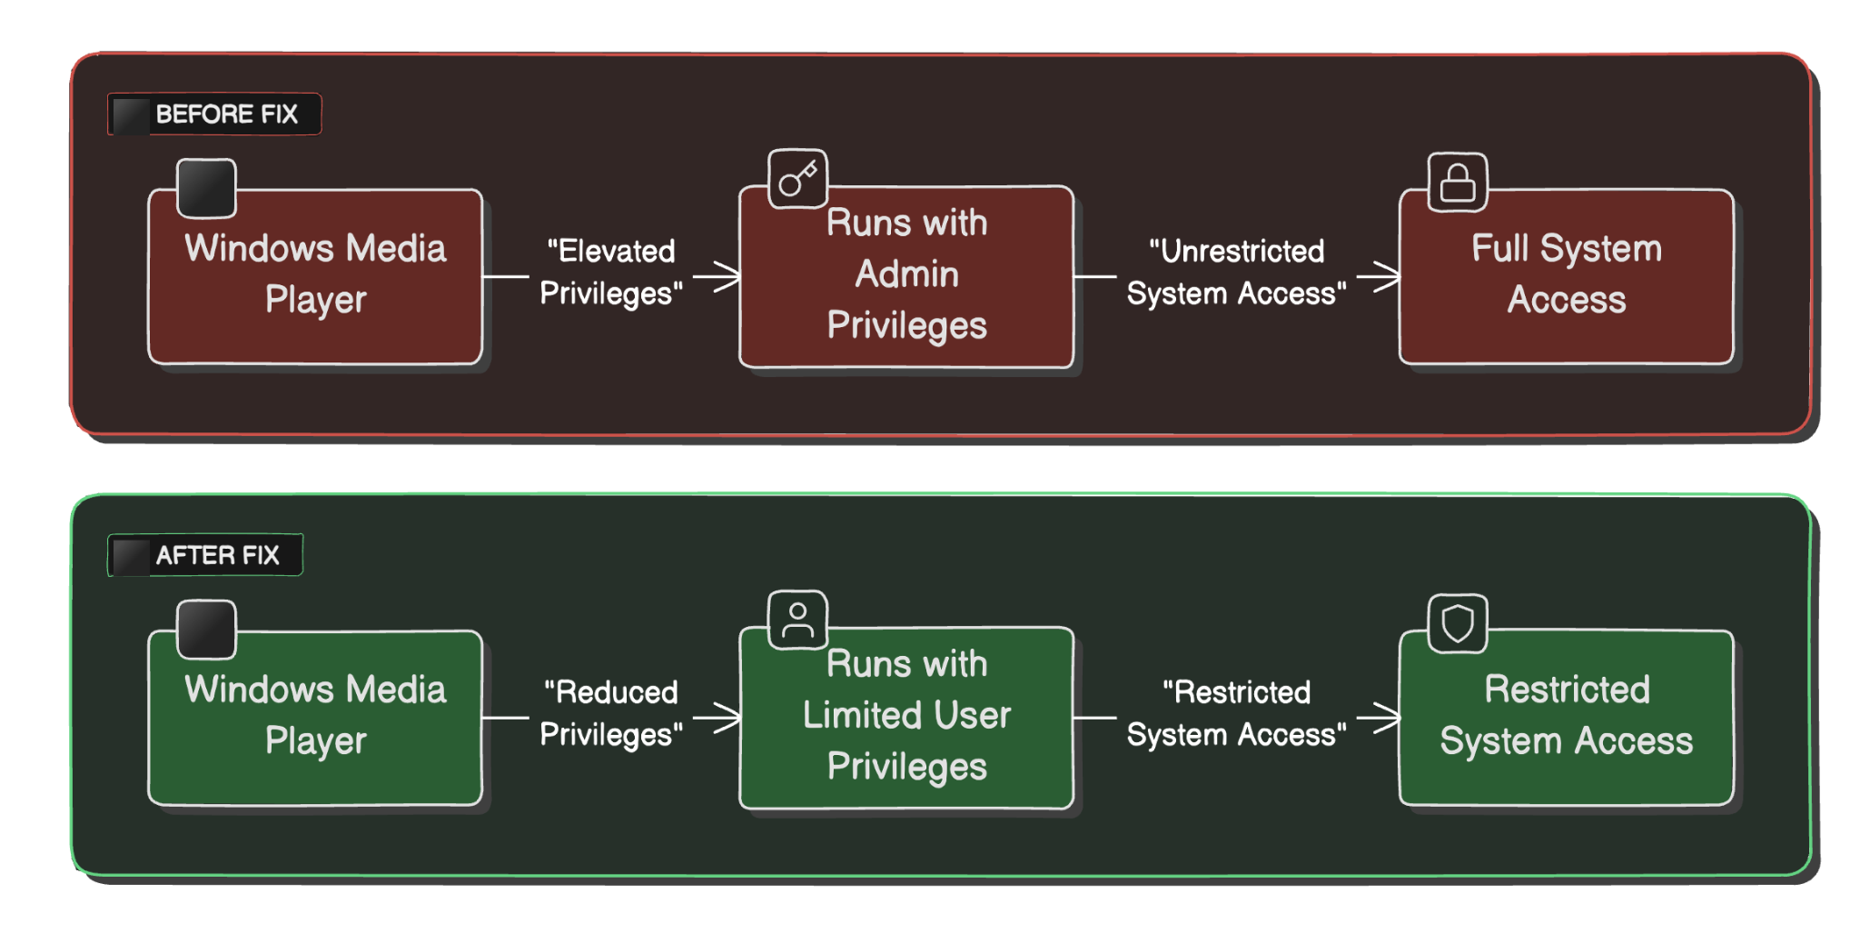
Real-Life Example: Windows Media Player

Slide 13
Implications of Excessive Privileges
• Increased Attack Surface: With higher privileges, an attacker has more capabilities, such as modifying system configurations.
• Severe Security Breaches: If a vulnerability is exploited in a high-privilege process, the attacker gains control over sensitive operations, compromising the entire system or network.
• Data Exposure: Attackers can access sensitive data inaccessible if the application or process was running with limited privileges.
• Examples:
• Windows XP: Many users ran with administrative accounts by default, resulting to widespread malware infections.
• Linux Servers: Web servers running as root can lead to full server takeovers when compromised.
Summary: Excessive privileges significantly increase the risk of system-wide breaches and data leaks, emphasizing the importance of implementing the least privilege principle.

Slide 14
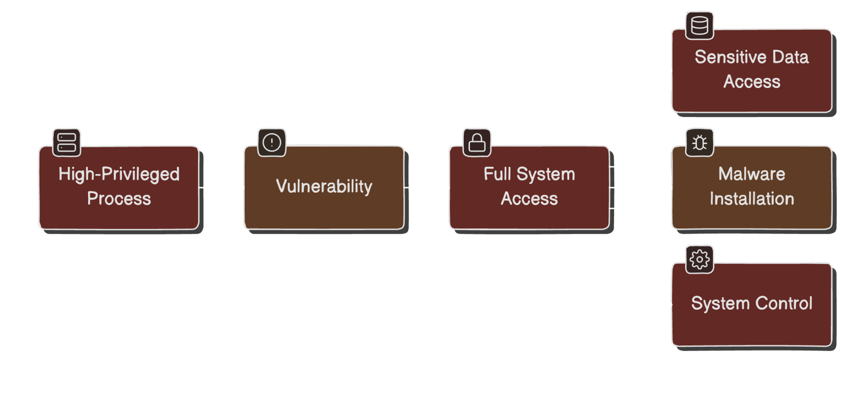
Implications of Excessive Privileges

Slide 15
Common Weakness Enumeration References for Privilege Issues
• CWE-250: Execution with Unnecessary Privileges: Running code with more privileges than necessary, a major cause of security vulnerabilities.
• CWE-269: Insecure Privilege Management: Points to flaws in how privileges are assigned or dropped within applications, often leading to privilege escalation attacks.
• CWE-271: Privilege Dropping/Lowering Errors: Errors occur when an application attempts to drop privileges incorrectly.
Key Message: These CWE references provide a framework for addressing privilege-related vulnerabilities during agile ceremonies of software development.
Summary: The Common Weakness Enumeration (CWE) provides clear guidelines and examples of privilege mismanagement issues, offering a roadmap for avoiding these pitfalls in software design.

Slide 16
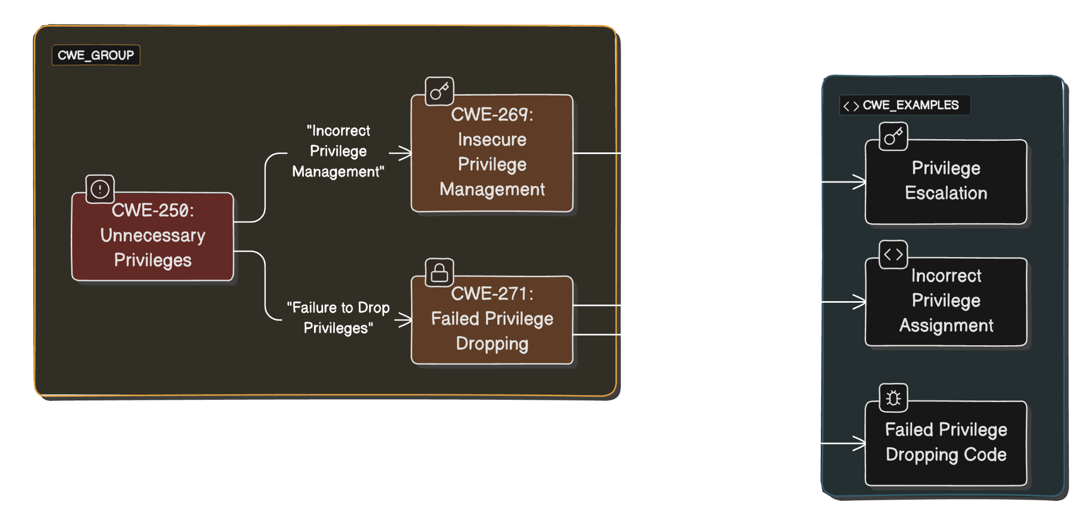
Common Weakness Enumeration References for Privilege Issues

Slide 17
Case Study: Windows Pre-Vista
• Default Administrative Accounts: In Windows XP and earlier, users often operated with full administrative privileges, increasing the attack surface.
• Impact on Security: Vulnerabilities in applications, like web browsers or media players, could escalate to full system compromises.
• Changes Introduced in Vista: Windows Vista introduced User Account Control (UAC), which enforced running applications with least privilege unless explicitly allowed, significantly reducing the risk of widespread system exploitation.

Slide 18
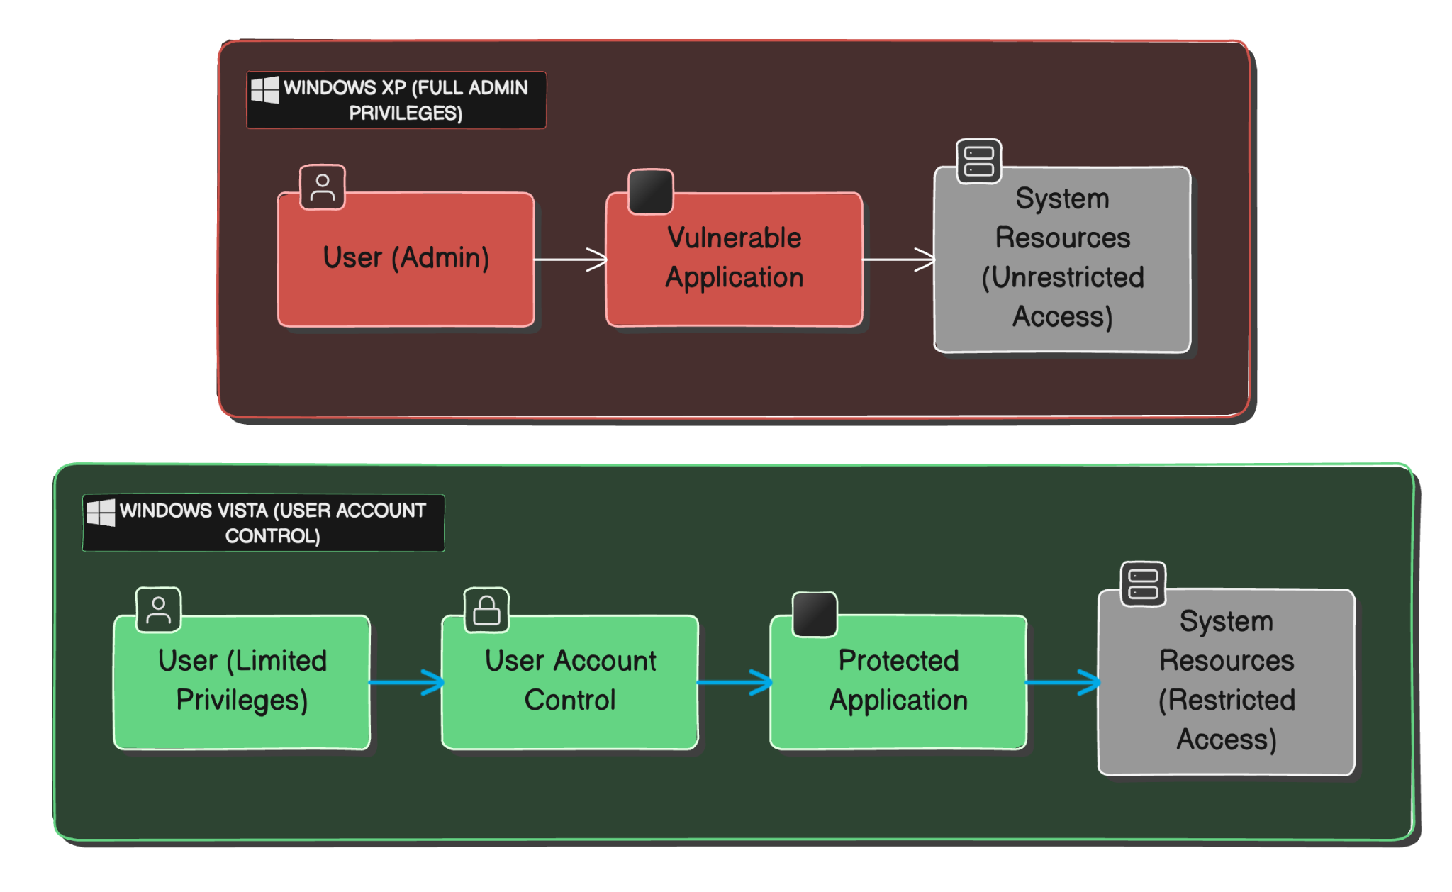
Case Study: Windows Pre-Vista

Slide 19
Spotting the Sin During Code Review
• Privilege Mapping: Ensure that the privileges required by each part of the application are well-documented and justified.
• Sensitive Function Calls: Review any instances where the application requests higher privileges, such as file system access, network services, or resource manipulation.
• Privilege Dropping: Check that code drops unnecessary privileges immediately after sensitive operations are complete.
• Common Pitfalls: Look for common mistakes, such as neglecting to check the success of privilege-lowering functions or using privileged accounts unnecessarily for routine operations.

Slide 20
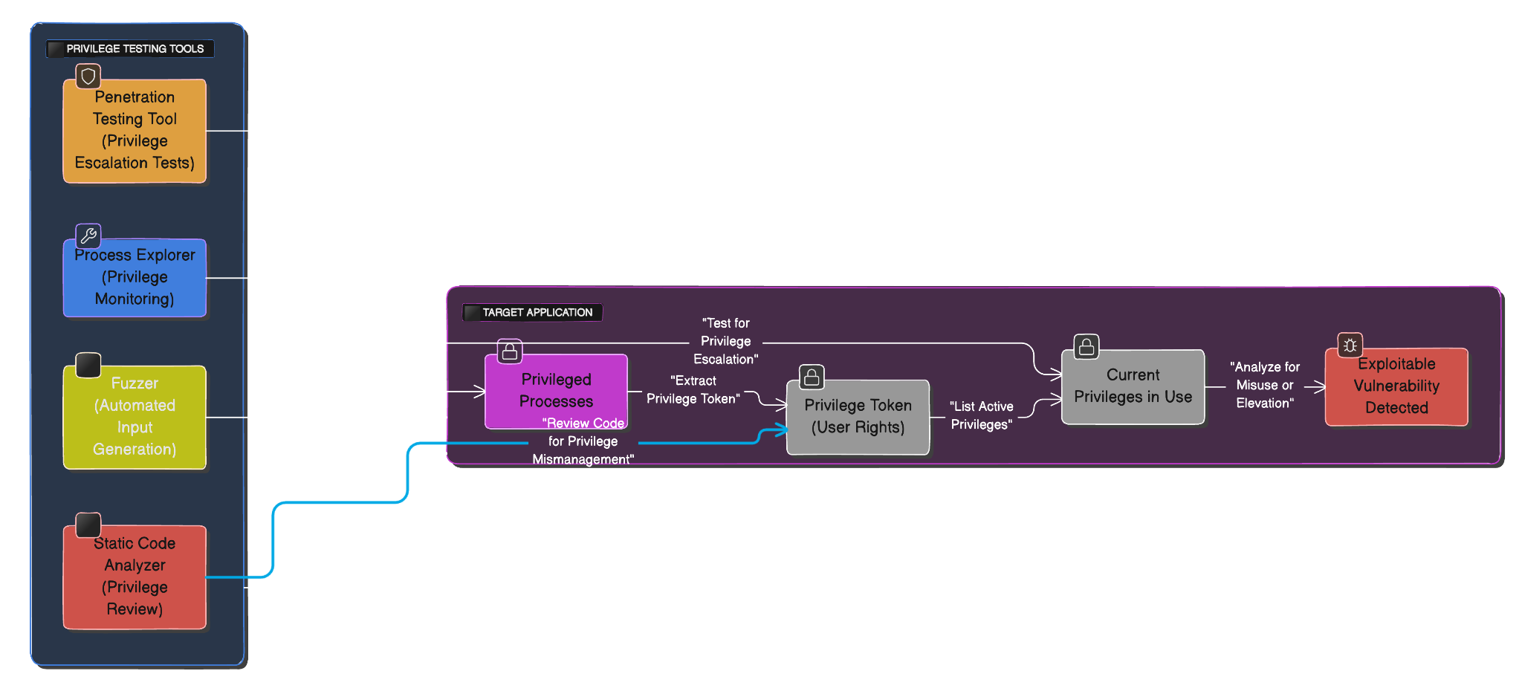
Testing for Privilege Mismanagement

Slide 21
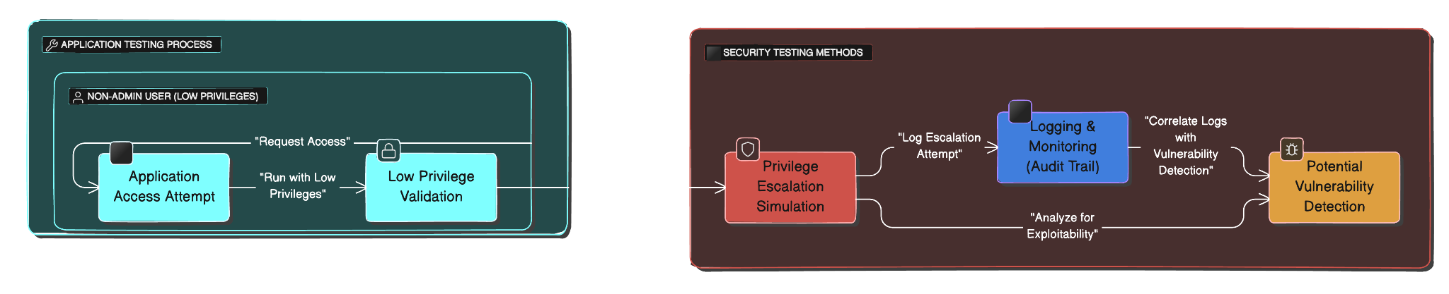
Spotting the Sin in Application Testing
• Run with Least Privilege: Test your application under non-administrator or low-privilege user accounts. If it fails, this could indicate that it is relying on unnecessary elevated privileges.
• Privilege Escalation Testing: Simulate attacks to determine if privilege escalation is possible, i.e., exploiting the application to gain higher-level privileges than intended.
• Use Security Testing Tools: Utilize tools like fuzzers or penetration testing suites to identify if vulnerabilities can be exploited due to the application’s privilege level.
• Logging and Monitoring: Ensure that any attempts to gain elevated privileges are logged and can be audited, as this will help in identifying misuse.

Slide 22
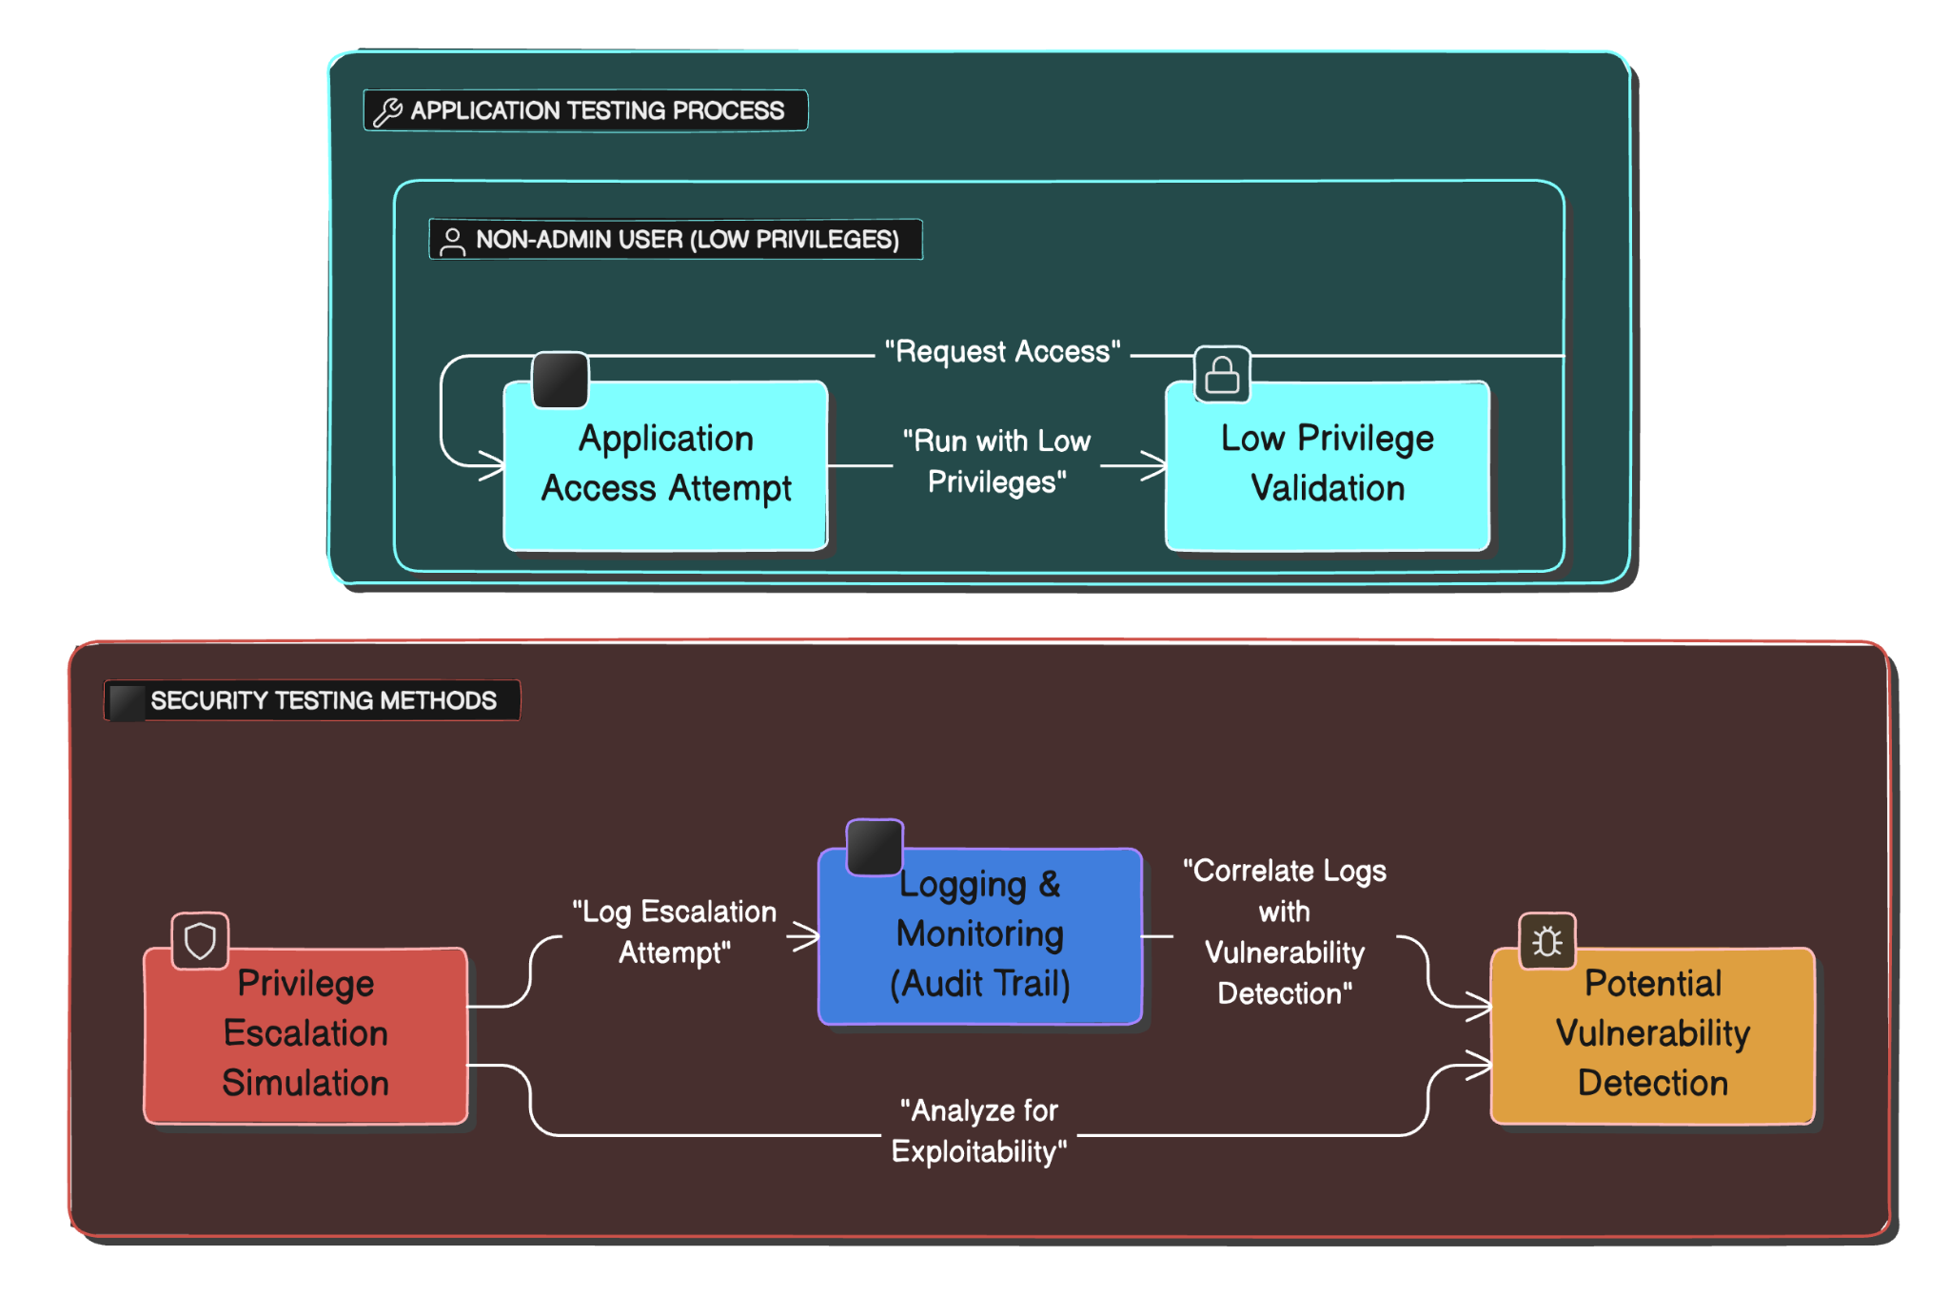
Spotting the Sin in Application Testing

Slide 23
Redemption Steps: Running with Least Privilege
• Principle of Least Privilege (PLP): Ensure that code and users operate with the minimum set of permissions required to perform their tasks.
• Key Steps for Redemption:
• Identify necessary privileges: Assess what permissions your application or service truly needs.
• Remove unnecessary privileges: Drop or disable any privileges that are not critical to the application’s functionality.
• Implement privilege separation: Ensure that processes or applications are compartmentalized, with sensitive operations being isolated.
• Time-Bound Privileges: Limit the time a process holds elevated privileges—return to lower privilege as soon as the sensitive task is completed.
• Granular Privilege Management: Leverage features like roles, tokens, or capabilities to enforce fine-grained control over system permissions.

Slide 24
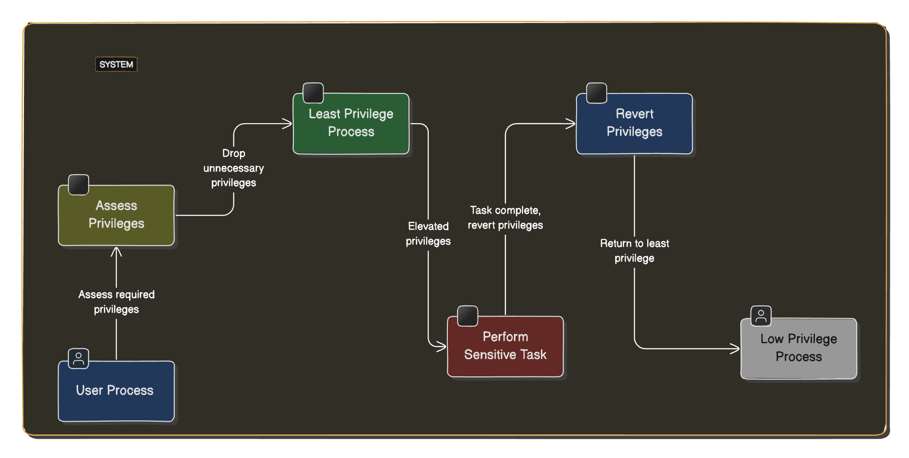
Redemption Steps: Running with Least Privilege

Slide 25
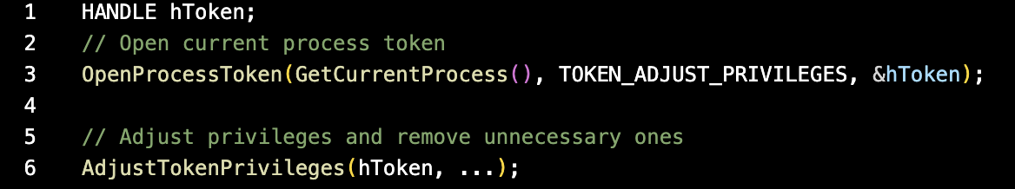
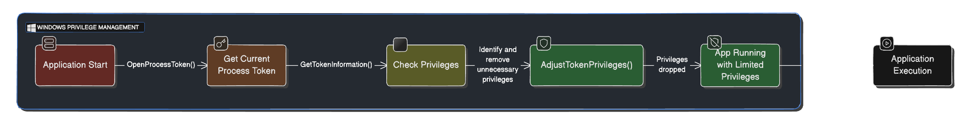
Windows-Specific Redemption: Dropping Privileges
• Privilege Reduction in Windows:
• In Windows, privileges can be managed via tokens that determine the access level of processes.
• Token Adjustments:
• Use the AdjustTokenPrivileges() function to strip unnecessary privileges from processes.
• Example: Removing administrative-level capabilities early in the application lifecycle ensures minimal exposure.

Slide 26
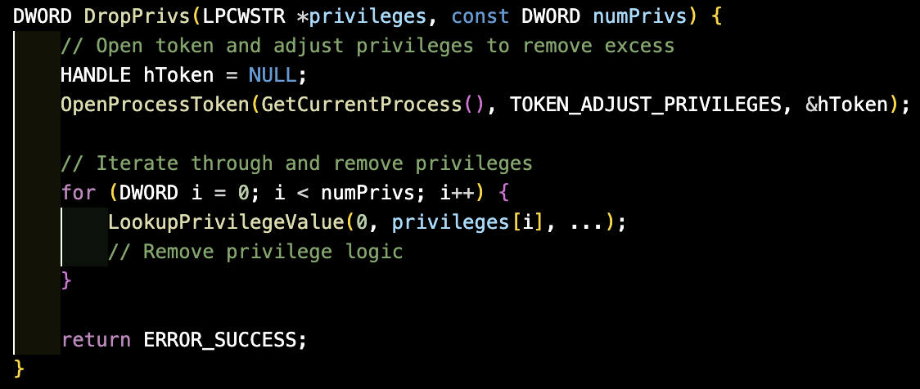
Example Redemption Code: Windows
• Practical Implementation of Privilege Reduction:
• Step 1: Identify which privileges your application requires to run.
• Step 2: Strip the privileges not needed using DropPrivs() (example below).
• Core Concept: Privilege stripping should be initiated as early as possible in the application’s execution lifecycle to reduce attack surface.

Slide 27
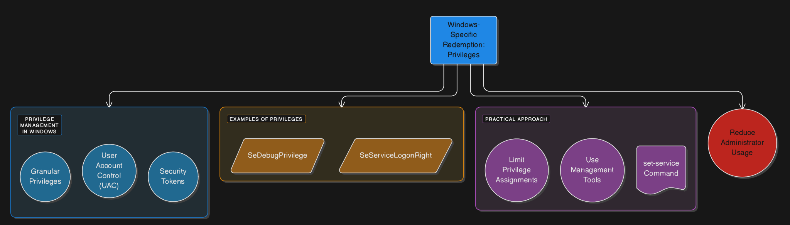
Example Redemption Code: Windows

Slide 28
Linux-Specific Redemption: Capabilities
Linux-Specific Redemption: Capabilities
• Capabilities in Linux:
• Unlike Windows, Linux does not have granular privilege tokens but supports capabilities for fine-grained access control.
• Examples of Capabilities:
• CAP_SYS_ADMIN: High-level system capabilities, often overused—should be limited.
• CAP_NET_BIND_SERVICE: Allows binding to privileged ports (e.g., port 80).
• Practical Approach:
• Limit the scope of capabilities granted to processes. For example, only grant CAP_NET_BIND_SERVICE to processes that need to listen on port 80.
• Use tools like libcap to remove or set capabilities at runtime.
• Example:
setcap 'cap_net_bind_service=+ep' /usr/sbin/myservice
• Reducing Privileges in Linux: Minimize the use of root by leveraging capabilities to grant specific permissions rather than broad administrative rights.

Slide 29
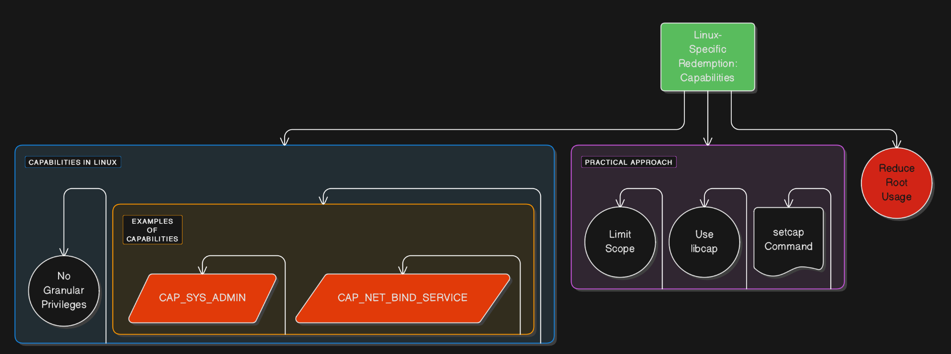
Linux-Specific Redemption: Capabilities

Slide 30
.NET Privilege Management
• Granular Permissions in .NET:
• .NET framework offers extensive control over permissions through Code Access Security (CAS) and other security policies.
• Restricting Permissions:
• Deny specific permissions via declarative or imperative security actions in code.
• Example: Denying socket access in C# to prevent network abuse:
[SocketPermission(SecurityAction.Deny)]
• Partial Trust Execution:
• Enforce that the application runs with partial trust, only granting the permissions that are necessary.
• Code Signing and Security:
• Use strong names and digital signatures to ensure that only trusted code runs with the necessary permissions.

Slide 31
Extra Defensive Measures
• Sandboxing: Restrict code execution environments to limit access to system resources and sensitive data. Use sandboxes in Windows, Linux (e.g., AppArmor, SELinux), and macOS to create controlled environments.
• Access Control Lists (ACLs): Implement fine-grained ACLs to control which accounts or processes have access to certain files and directories. Ensure that sensitive resources are accessible only to the minimum set of necessary users.
• Regular Audits: Conduct frequent audits of privilege levels across applications and services. Automated tools can detect privilege escalation vulnerabilities in real-time.
• Separation of Duties: Design systems with distinct roles for users, services, and applications. This ensures that no single entity has excessive power, thereby limiting the potential impact of a breach.

Slide 32
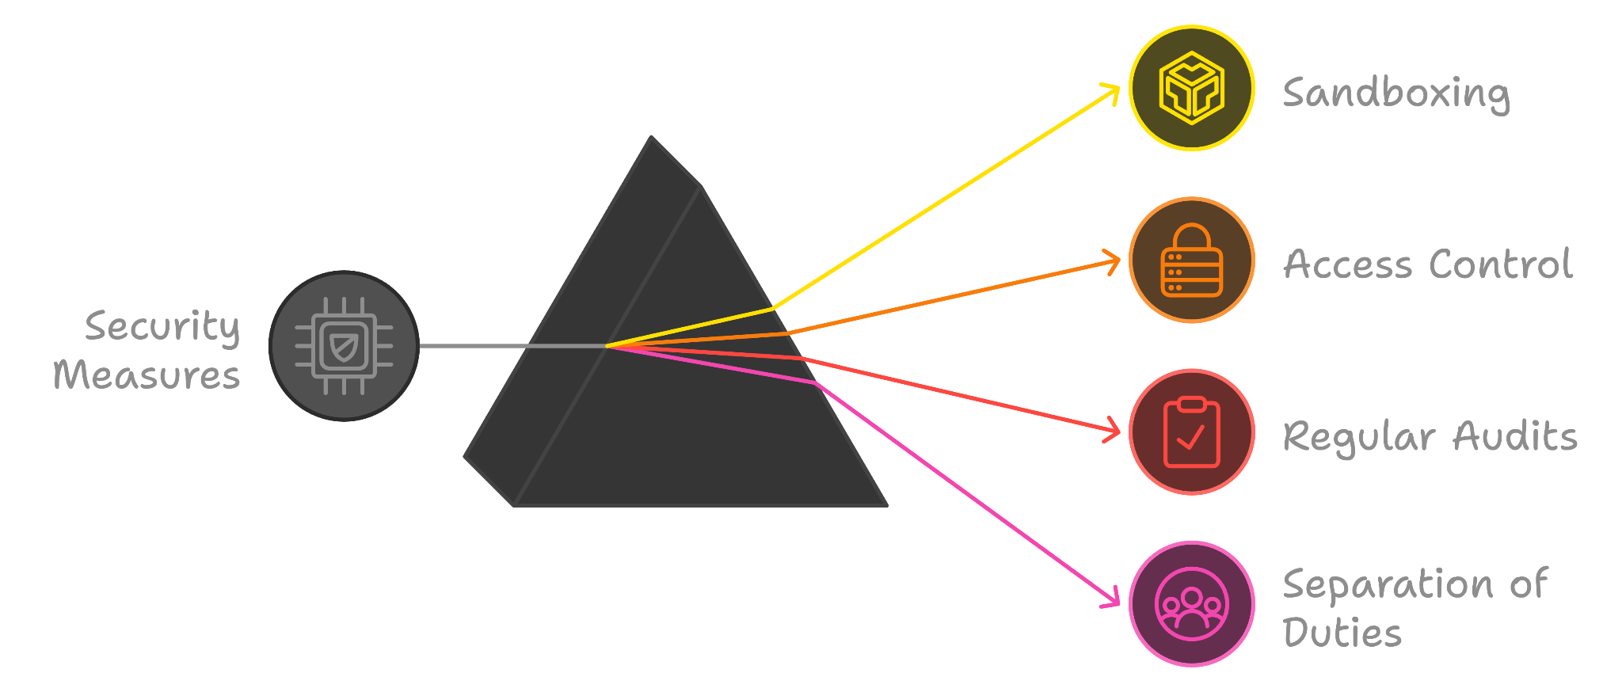
Extra Defensive Measures

Slide 33
Challenges in Applying Least Privilege
• Balancing Usability and Security: Users often demand elevated privileges to avoid “access denied” errors. Balancing this need with security is tricky, as overly restrictive policies can disrupt workflow.
• Complex Application Requirements: Some applications may need temporary elevation of privileges for specific tasks. Designing systems that allow for dynamic privilege adjustment while maintaining security is difficult.
• Legacy Systems: Older applications might have been designed to run with administrative privileges by default. Retrofitting these systems to adhere to least privilege is often costly and time-consuming.
• Dynamic Cloud Environments: In cloud environments, managing privileges becomes more intricate due to the dynamic nature of resources and services. Implementing and enforcing least privilege across cloud-native applications requires specialized tools and careful monitoring.

Slide 34
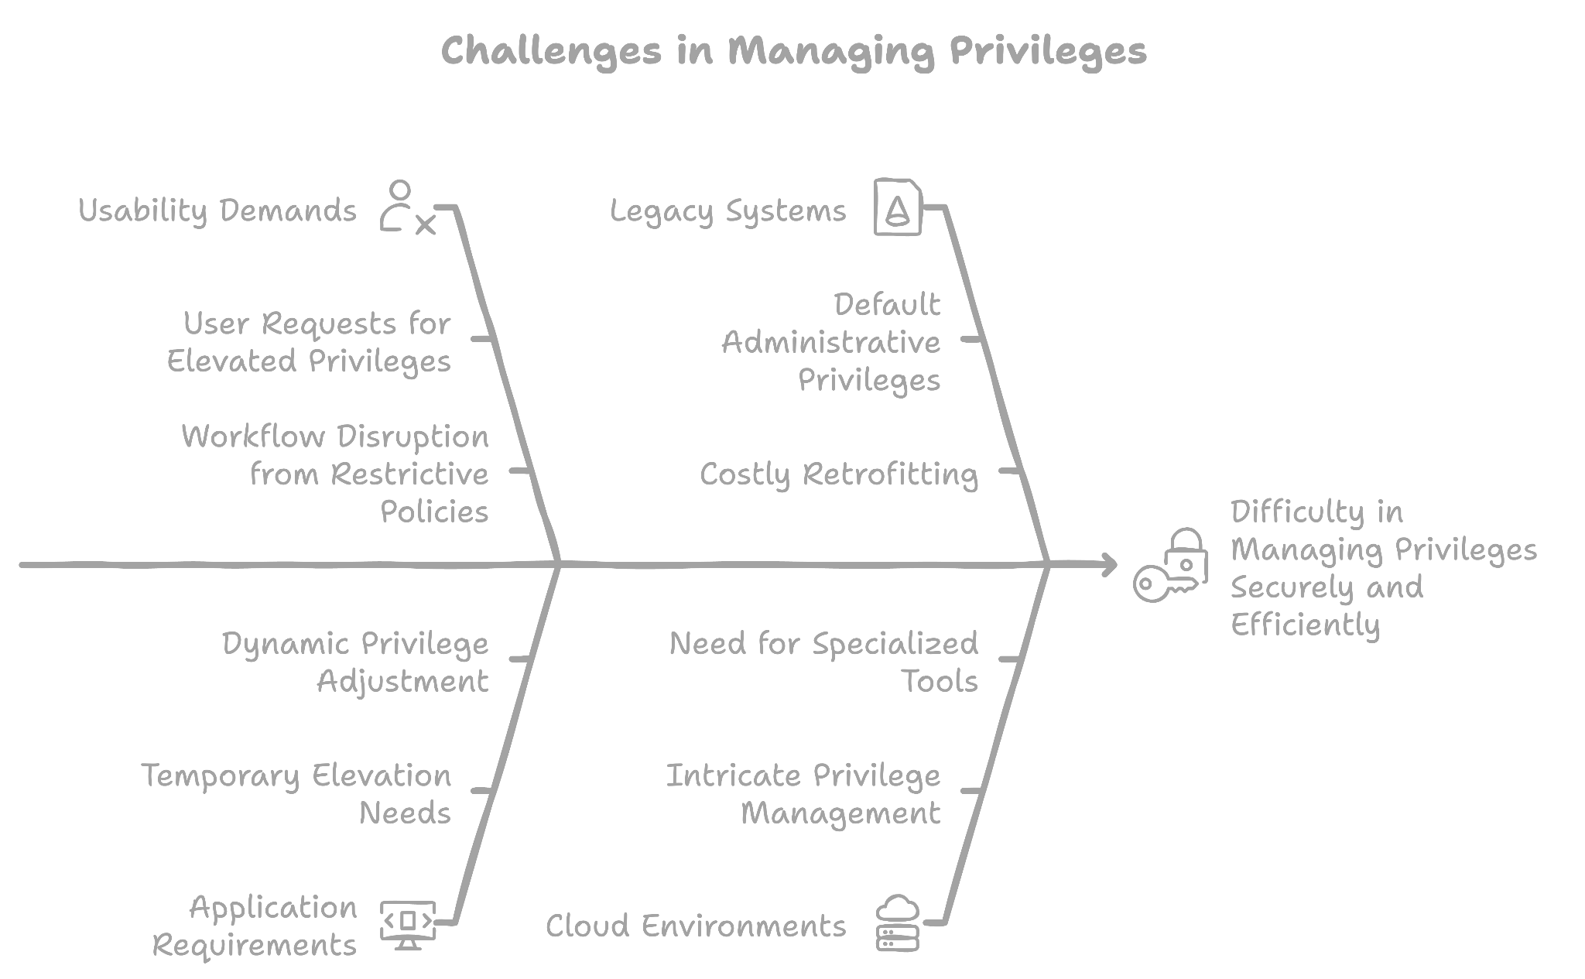
Challenges in Applying Least Privilege

Slide 35
Service Privilege Management in Windows
• Service-Specific Privileges: Assign only the necessary privileges to each service. Use the ChangeServiceConfig2() API to restrict service privileges programmatically, ensuring minimal access.
• Service Accounts: Run services under specific accounts (e.g., “Network Service” or “Local Service”) instead of the highly privileged “Local System” account. This limits the damage in case of a breach, as these accounts have restricted access to the system.
• Separation of Services: For services that handle sensitive data or operations, separate them into smaller, isolated services. Assign each service the minimum privileges required to perform its function.

Slide 36
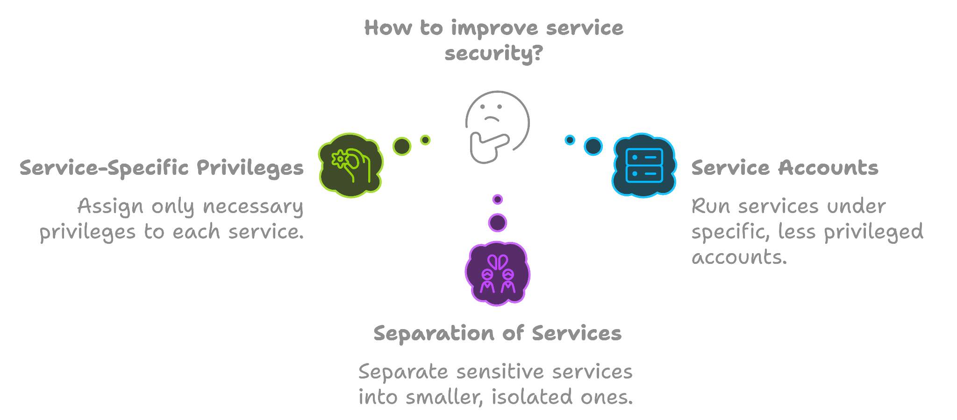
Service Privilege Management in Windows

Slide 37
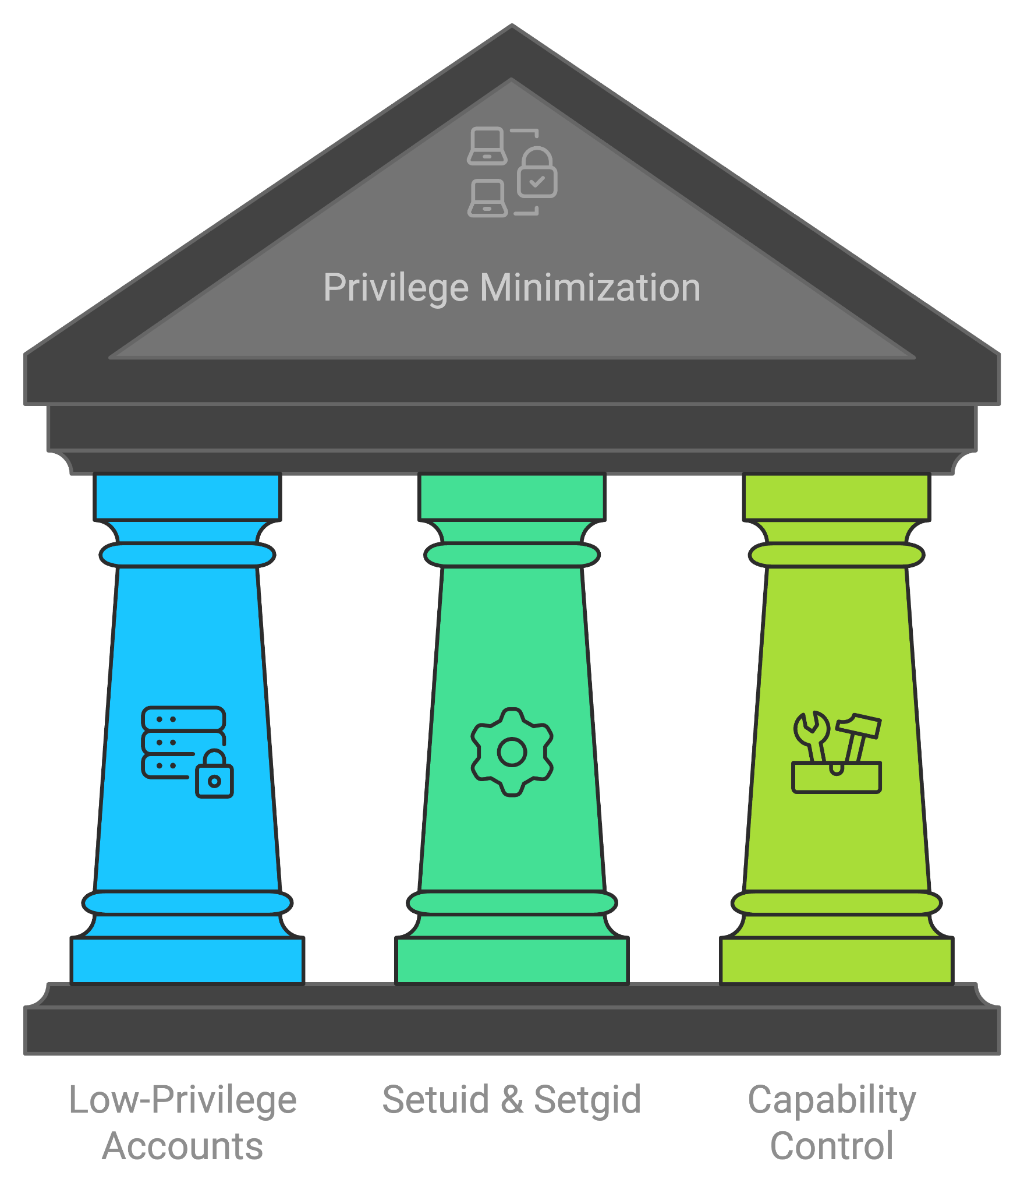
Service Privilege Management in Linux
• Using Low-Privilege Accounts: Run services under dedicated, low-privilege accounts. For example, web servers often use accounts like “www-data” or “nobody” with restricted access to system files.
• Setuid and Setgid: Use the setuid and setgid functions to drop privileges after starting the service. This limits the process to the privileges of a less-privileged user, reducing potential damage from exploitation.
• Capability Control: Utilize Linux capabilities to grant only the necessary permissions. For example, a time synchronization service might only need CAP_SYS_TIME to adjust the system clock. Tools like libcap and setcap help assign specific capabilities to executables, avoiding the need to run services as root.

Slide 38
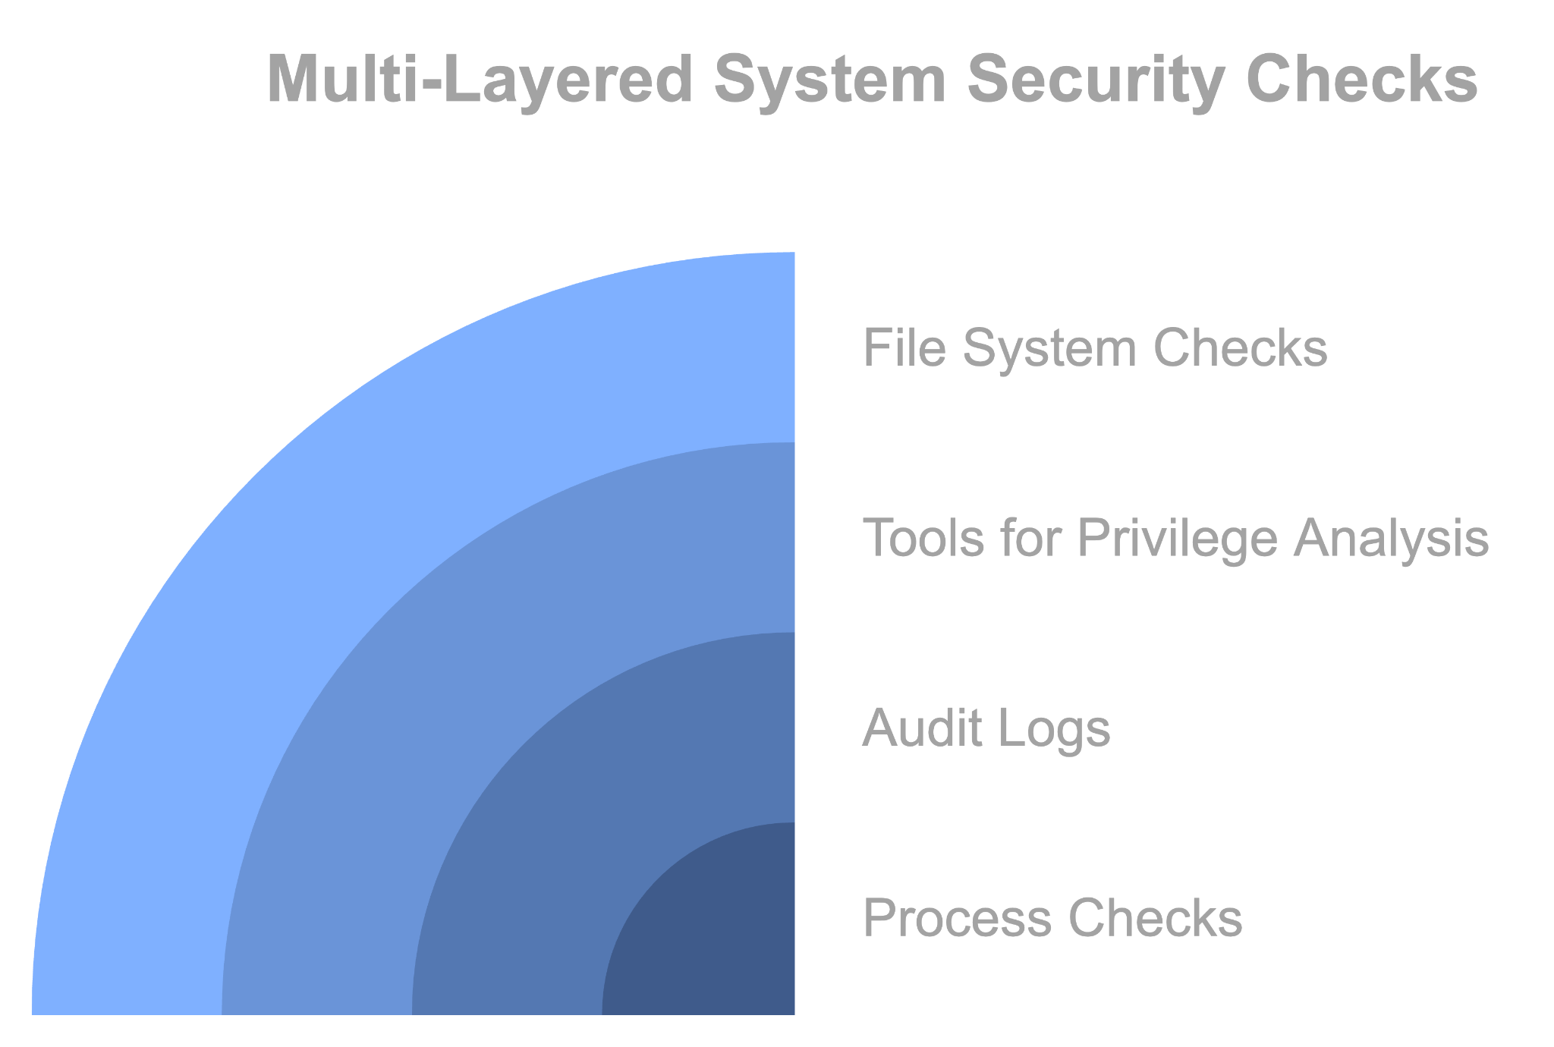
Spotting Elevated Privileges in Linux
• Using ps Command: Use commands like ps -U root or ps -G wheel to list processes running as root or with elevated group privileges. Look for any unexpected applications in these lists.
• Audit Logs: Regularly check system audit logs (e.g., /var/log/auth.log on Ubuntu) for instances of privilege escalation. Unusual entries can indicate security issues that need investigation.
• Tools for Privilege Analysis: Use tools like chkrootkit, lynis, or auditd to identify processes with elevated privileges and detect potential rootkits or backdoors.
• File System Checks: Inspect binaries with the setuid or setgid bits using find commands, such as find / -perm -4000, to locate files that execute with elevated privileges. Review these files to ensure they are secure and necessary.

Slide 39
Zero Trust Model
How do we implement Zero Trust to mitigate excessive Privileges?
1. Strict Access Controls
• Role-Based Access Control (RBAC): Assign permissions based on roles rather than individuals.
• Just-In-Time Access: Provide temporary access permissions which expire after a certain period, reducing the window of opportunity for misuse.
2. Verification of Code and Applications
• Code Signing: Ensure all code is digitally signed before execution to prevent malicious code from running.
• Application Whitelisting: Only allow approved applications to execute, blocking untrusted software.
3. Network Security Measures
• Micro-Segmentation: Use software-defined networking to create secure zones within your network.
• Encrypted Communication: Encrypt data in transit to prevent interception by malicious code with elevated privileges.

Slide 40
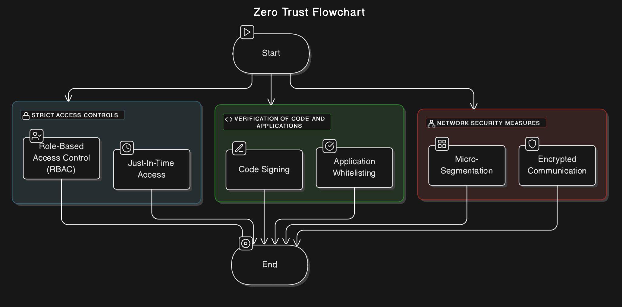
Zero Trust Model

Slide 41
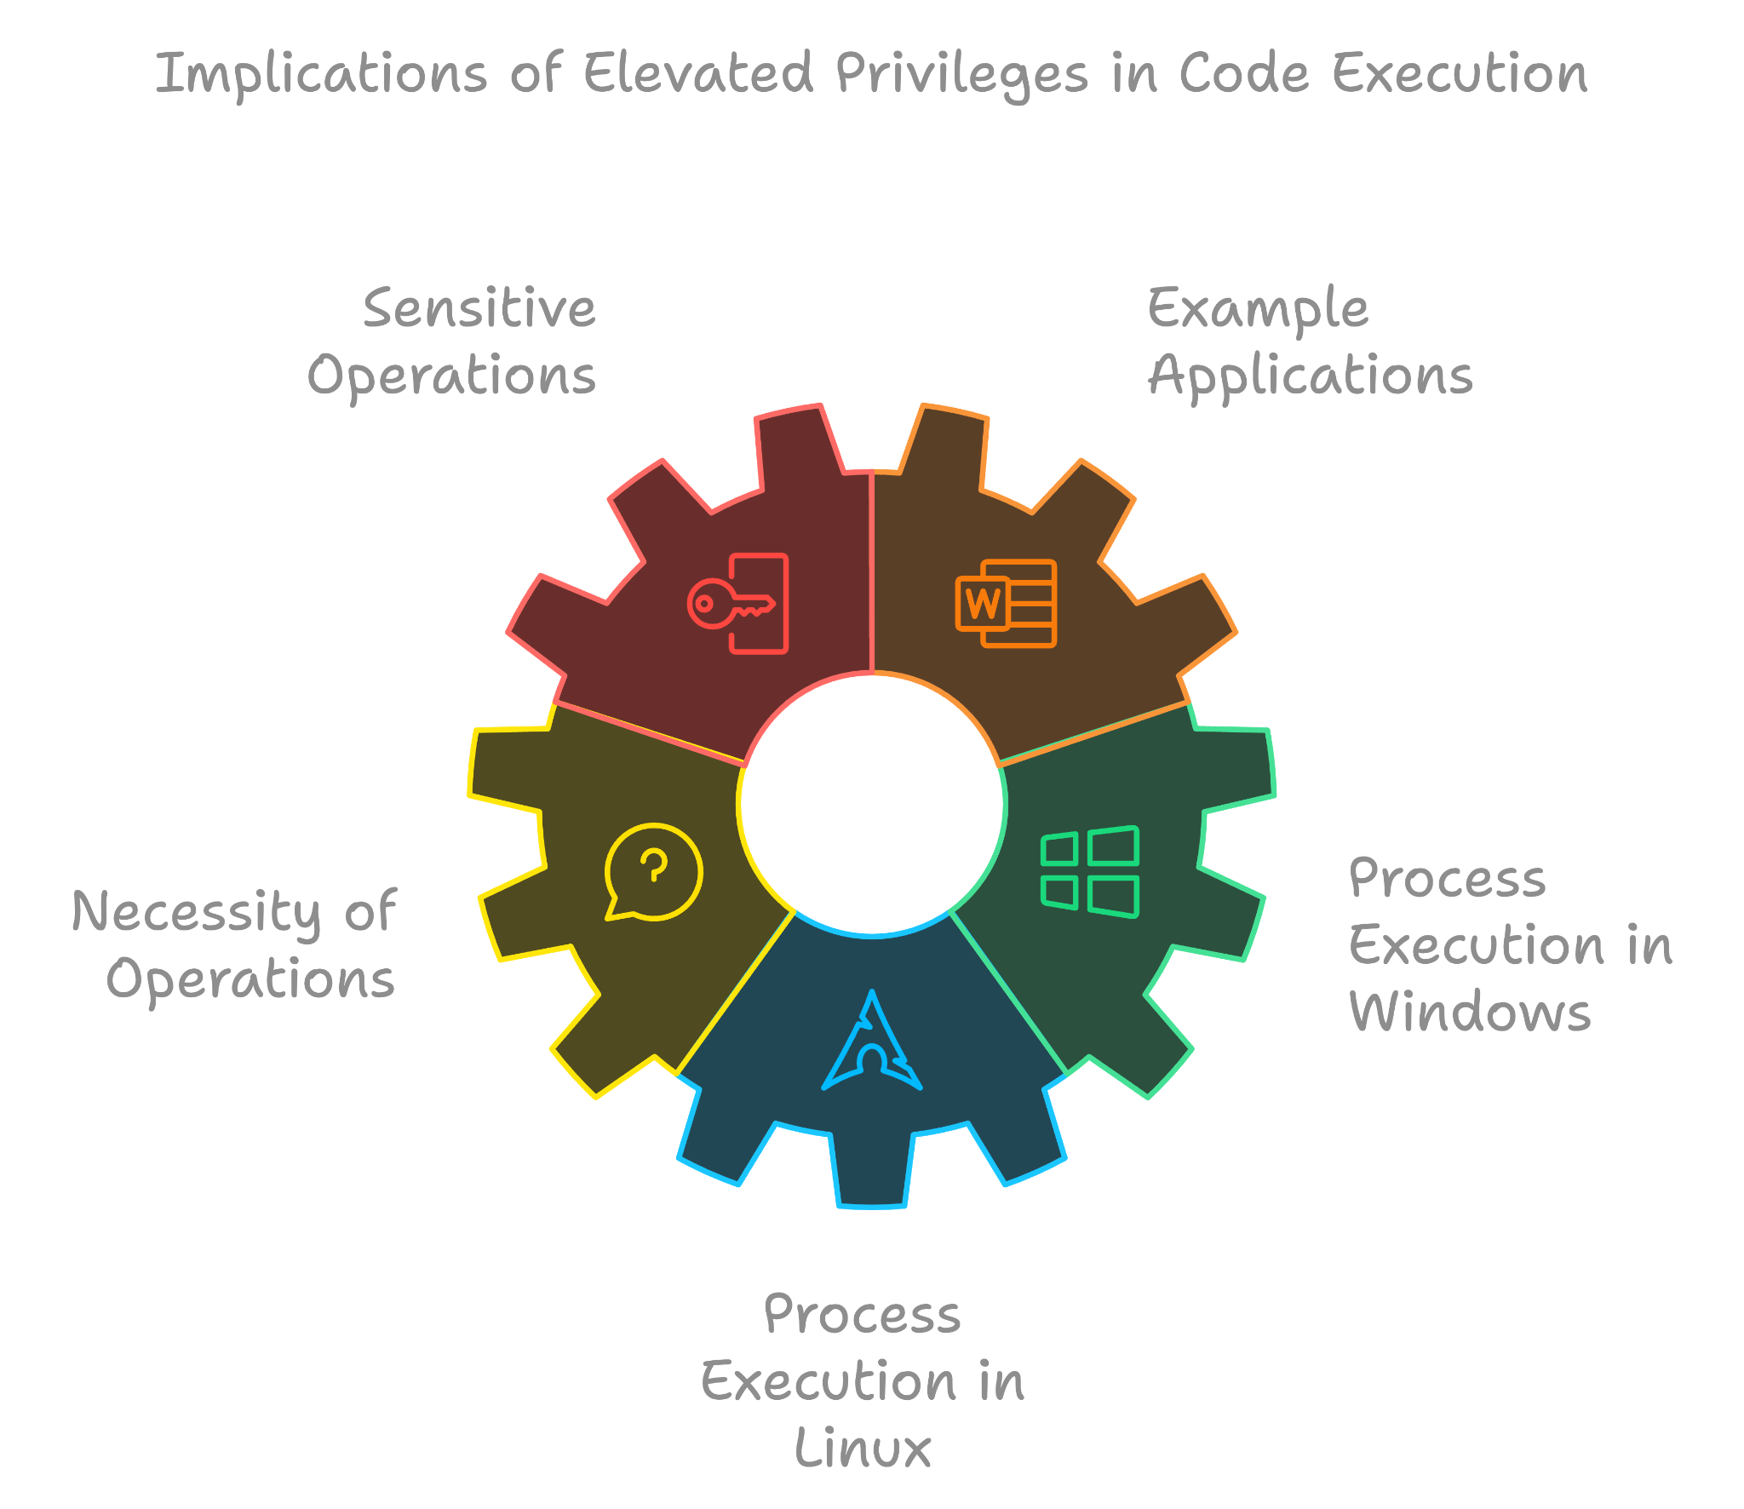
High Privilege
Code has ability to perform sensitive operations as they are run with elevated privileges
For example, a word processing application with the ability to start/stop services or open ports
Are these operations necessary for the process?
Consider how processes are run
Windows “Run as Administrator” pop-up
Linux “sudo” command

Slide 42
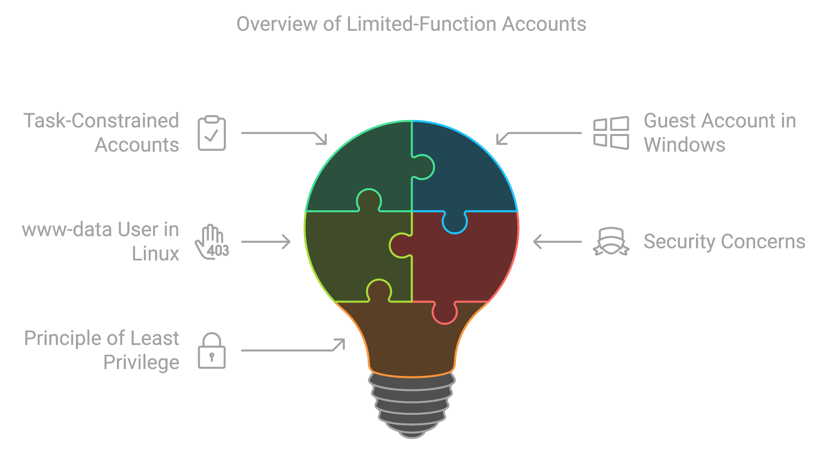
Low Privilege
Code running under accounts that are task-constrained or have limited functions that they can perform.
The Guest account in Windows
Has its own security concerns and should be used appropriately
www-data user in Linux
Used specifically for web server
Helps mitigate the effects of a compromised server – Principle of Least Privilege
The accounts’ limited rights limit the damage that can be done

Slide 43
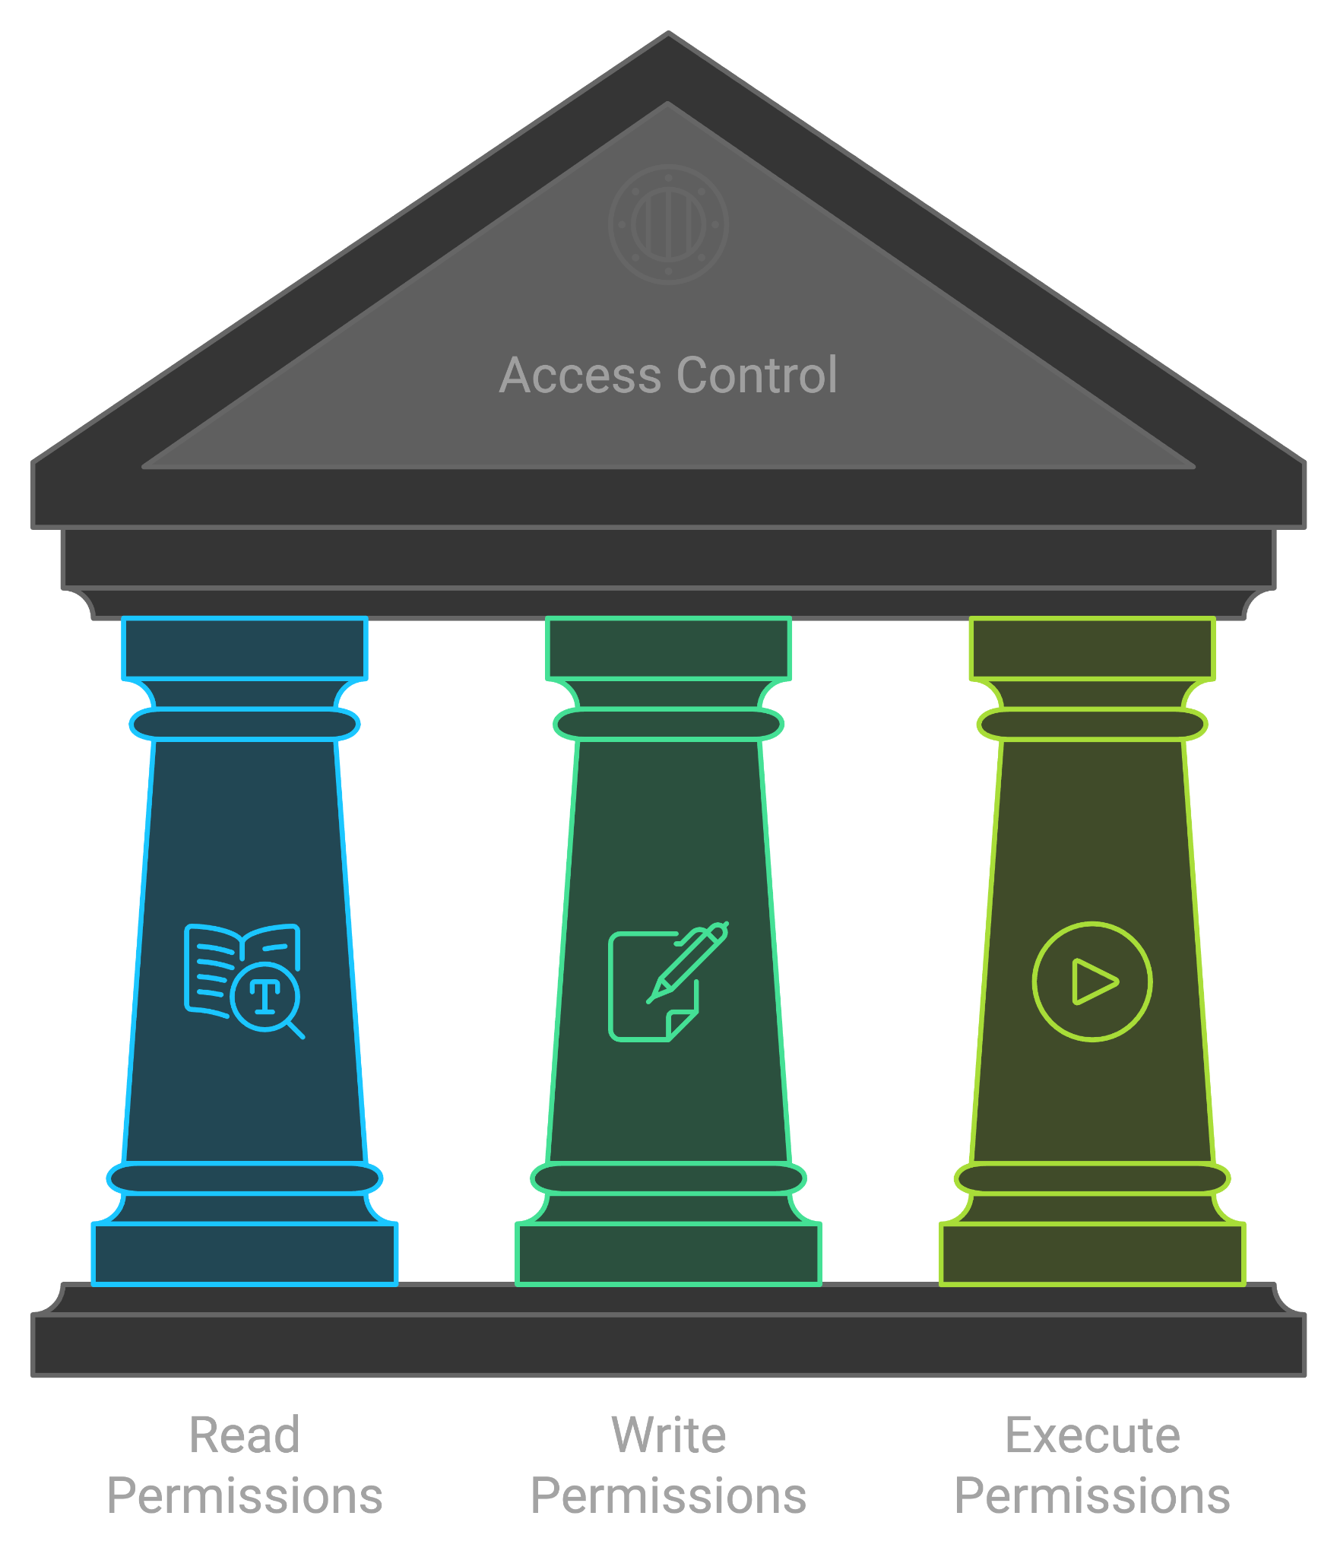
Access Control
Access Control: "A means of restricting access by specified entities to specific resources--the ultimate goal being to protect resources from unauthorized access“
Read permissions state a user may read a file, document, code, etc
Write privileges state a user may edit the material in question
Execute privileges state a user may run and execute the program or subject matter in question.
Overly strict Access Control Lists can further indulge this sin
“If a resource has a highly restrictive access control, then it can only be accessed by code running with elevated privileges” (24 Deadly Sins, Michael Howard et al)

Slide 44
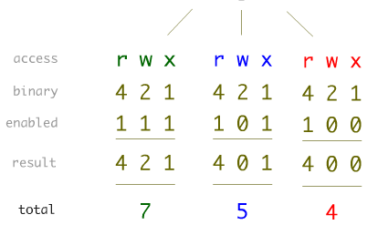
Permissions in UNIX
Binary flags set file permissions
r(ead)=4
w(rite)=2
(e)x(ecute) =1
Order is for access
First number is file owner
Second number is group owner
Third is every other user
0 | 1 | 2 | 3 | 4 | 5 | 6 | 7
- - - | - - x | - w - | - w x | r - - | r - x | r w - | r w x

Slide 45
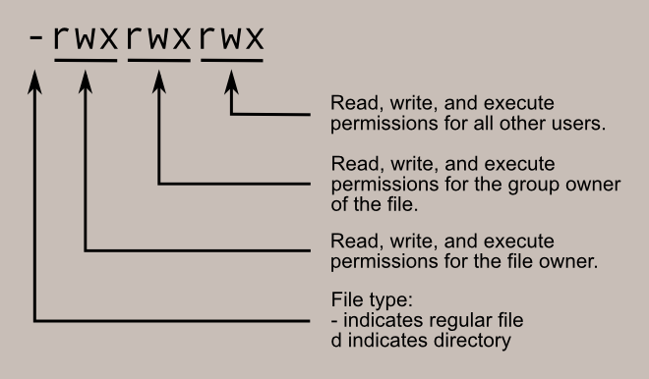
Permissions in UNIX (cont.)
ls -l command to see the permissions granted
Privileges can be modified using chmod
E.g. chmod u+r
‘u’ refers to whose permission is being modified
‘u’ for user, ‘g’ for group, ‘o’ for other
‘+’ refers to giving permission
‘+’ to add permission, ‘-’ to remove permission
‘r’ refers to permission
‘r’ for read, ‘w’ for write, ‘x’ for execute

Slide 46
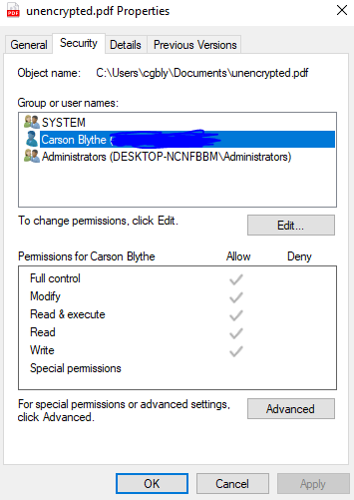
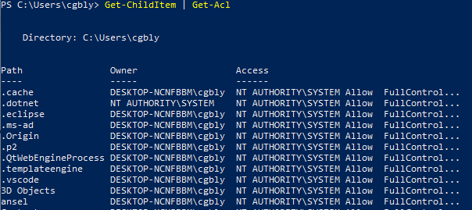
Permissions in Windows
Permissions can be seen in PowerShell via Get-ChildItem | Get-Acl
Get-ChildItem equivalent to ‘dir’ and ‘ls’
Permissions often set via GUI in File Properties

Slide 47
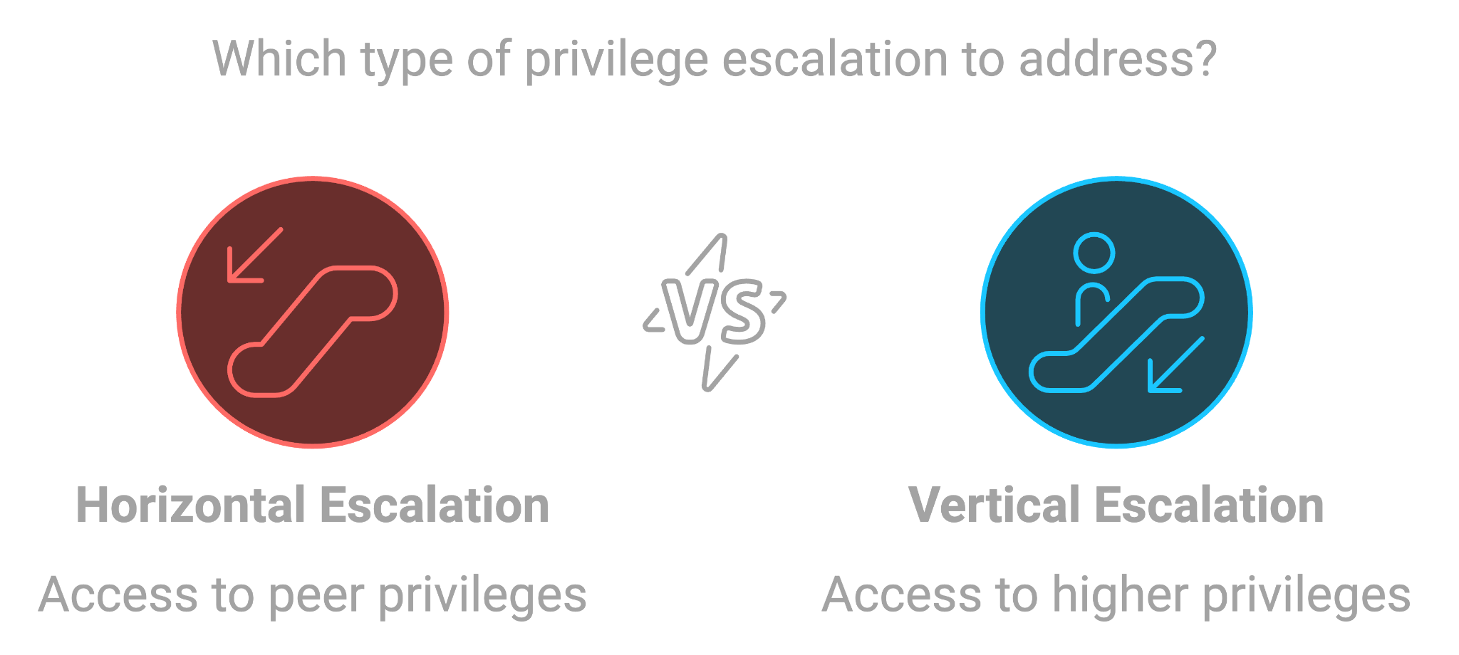
Privilege Escalation
Privilege escalation occurs where a bad actor gains access into an organization's infrastructure and gets higher privileges
The bad actor gains privileges that should normally be off-limits to them, such as administrative powers
Two forms – Horizontal and Vertical Privilege Escalation

Slide 48
Horizontal Privilege Escalation
Not exactly an escalation of privileges
Consider the following example:
Users A and B both have their own online bank accounts
Through malicious activity (e.g. XSS, session hijacking), User A is able to access User B’s account
User A can access the account while access to User B’s account shouldn’t be part of User A’s privileges
No new higher-level privileges are gained

Slide 49
Vertical Privilege Escalation
Directly related to our sin
The sin can result in Vertical Privilege Escalation
Refers to the act of a user gaining more privileges than intended
I.e. a person that should have regular user rights now having administrative rights
Often occurs through various exploitation of programs that have higher-level rights
If a program being run has administrative rights, a buffer overflow could run arbitrary code with those administrative rights

Slide 50
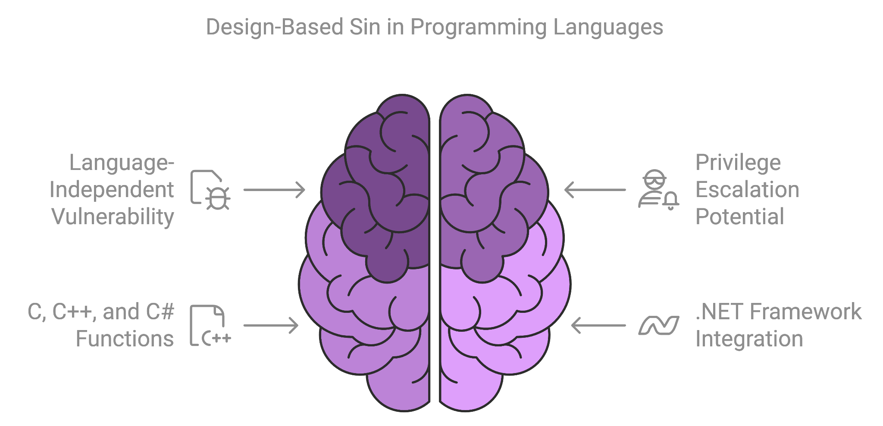
Affected Languages
The sin is NOT language-specific and is a design-based sin. Any avenue that allows for escalated privileges is potentially vulnerable to the sin
This sin can affect each and every language, as every language can be used to escalate privileges, and can therefore be used in a privilege escalation attack.
Many languages, however, have functions that can manage process permissions. C, C++, and C# all have functions that can go along with the .NET Framework.

Slide 51
Why Does it Happen?
Often times, giving processes or the people who run them more rights than needed “just works” and requires less consideration and thought
Can be time-consuming or overbearing to comb over either the process or an Active Directory to set appropriate privileges
Lots of static code analysis to set privileges in the right spots and ensure that the privileges are de-escalated after in every case
A network with thousands of users (e.g. businesses, schools) may have numerous users that need certain privileges for their job in some places and not others to varying degree

Slide 52
Python Example
def makeNewUserDir(username): if invalidUsername(username): #avoid CWE-22 and CWE-78 print(Bad username’) return False
try: raisePrivileges() os.mkdir('/home/' + username) lowerPrivileges() except OSError: print('Unable to create directory) return False return True
Focus on the highlighted portion
Privileges are raised to run the command, and then lowered after
If os.mkdir() throws an exception, then the call to lowerPrivileges() will never happen
Program now indefinitely operating with raised privileges
https://cwe.mitre.org/data/definitions/269.html

Slide 53
Consequences
A program that is designed with this sin is vulnerable to privilege escalation
For some programs or users, this may mean very little
For programs that are more exploitable, especially if they contain other sins, this can be devastating

Slide 54
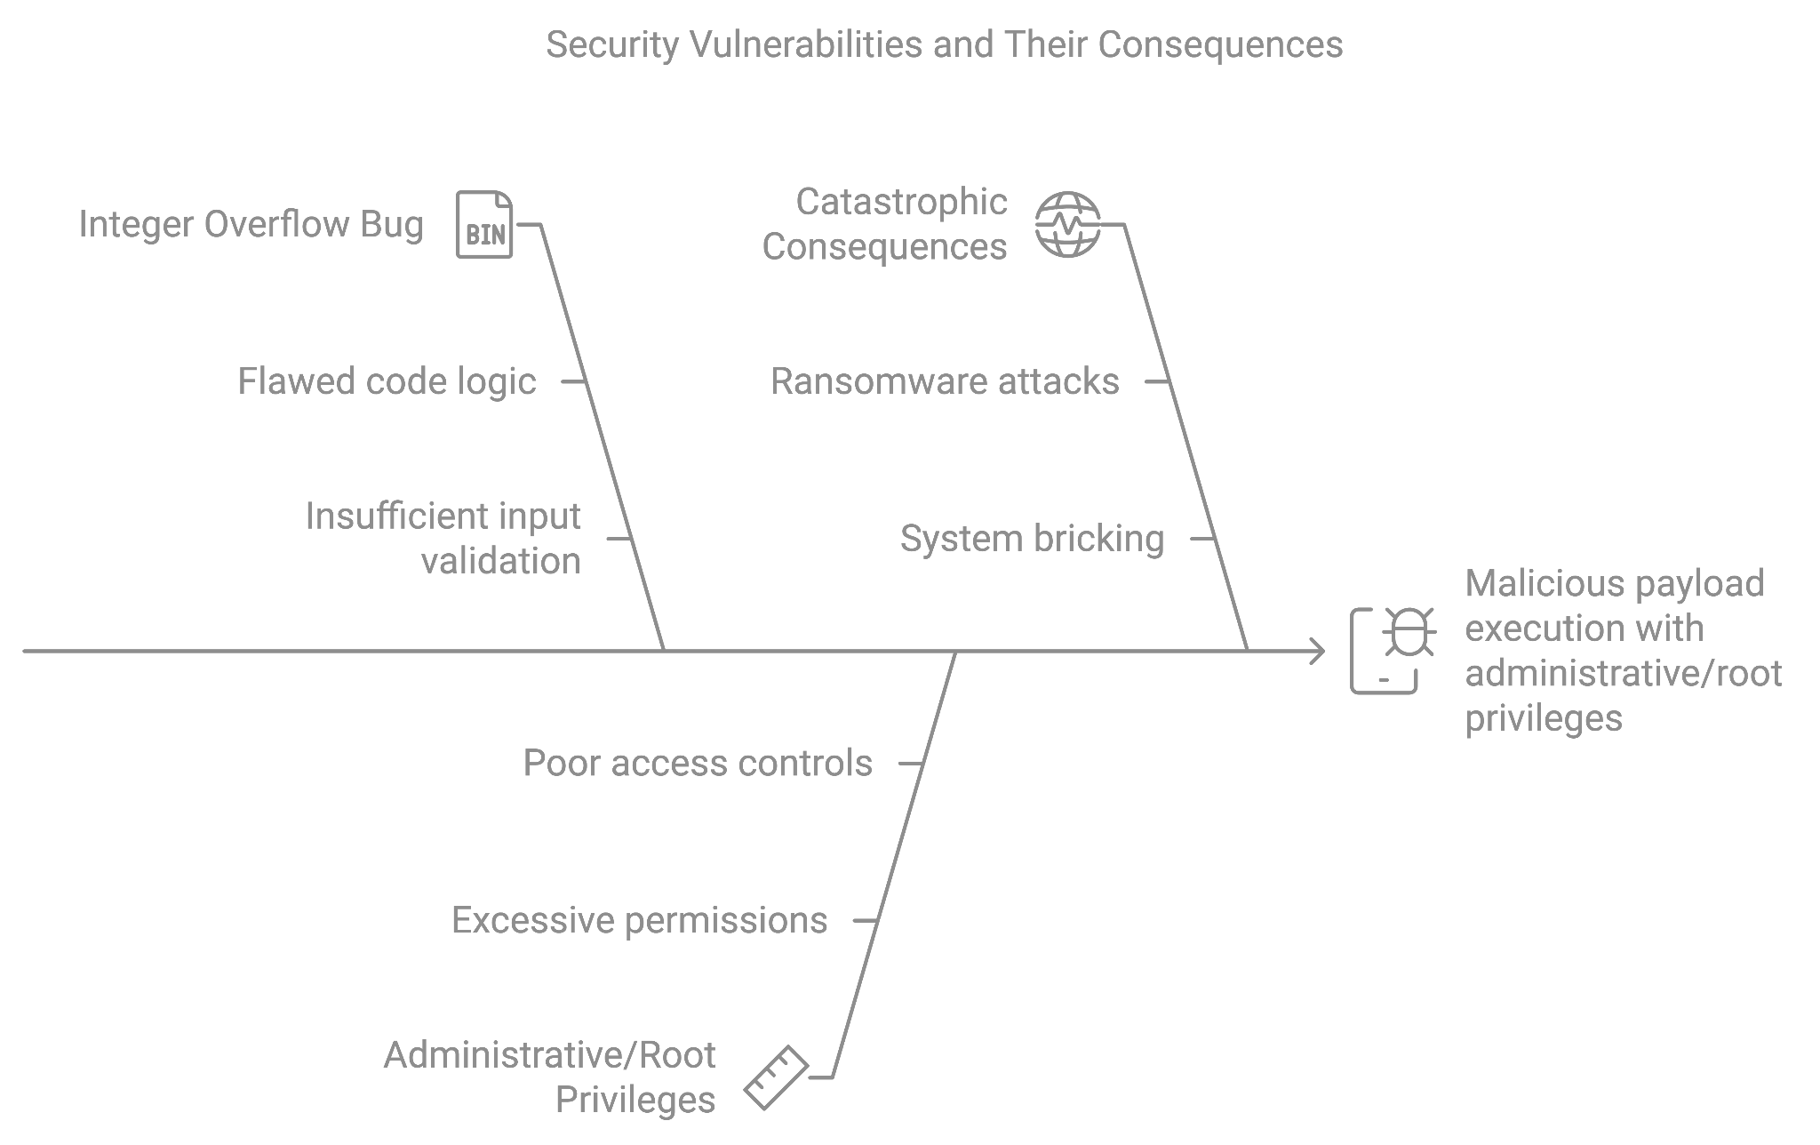
Even Worse With Other Sins
If a process runs with administrative or root privileges and there’s an integer overflow bug (Sin 7) in that code that leads to code execution, then the malicious payload will also run with administrative or root privileges
Moreso, this sin can make the consequences of other sins even more catastrophic – a malicious actor with administrative or root privileges can effectively run anything they want, resulting in ransomware, bricking the system, etc

Slide 55
Detecting the Sin
The sin is not easy to “detect” specifically before an attack happens
Code analysis (both static and dynamic) would be a good place to start for ensuring a program is more secure
Consider Quality Assurance teams that would search for such exploits as well as hobbyists through Bug Bounty programs
In general, the sin should be more of a habit of setting good practices so that it won’t need to be detected

Slide 56
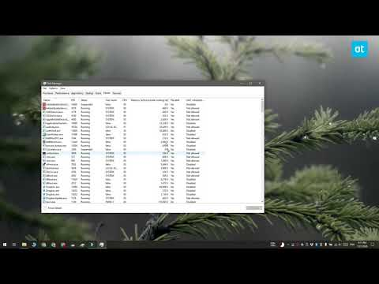
Finding Process Permissions
Windows
Process explorer from Sysinternals is a good tool to find process permissions.
Task Manager can be configured to display User Access Control information.
Mac/Linux
Use ps command to find what programs are run by root or users in the root/wheel group. You can also use top command to showing top running processes as well
How to check if a process is running as an administrator on Windows

Slide 57
Further Limitation
A good way to reduce permissions is by using code that strips unnecessary privileges from processes temporarily
It is important even for code run by root users. If the process does not need the elevated permissions, then it should run at a lower permission level
For an example of this code, see pages 248-249 of 24 Deadly Sins of Software Security
In Linux systems, limiting user accounts to lower privileges and then granting sudo permissions for necessary operations protects against this sin
It is even possible to limit the arguments able to be passed to a command with sudo for finer-grained restriction

Slide 58
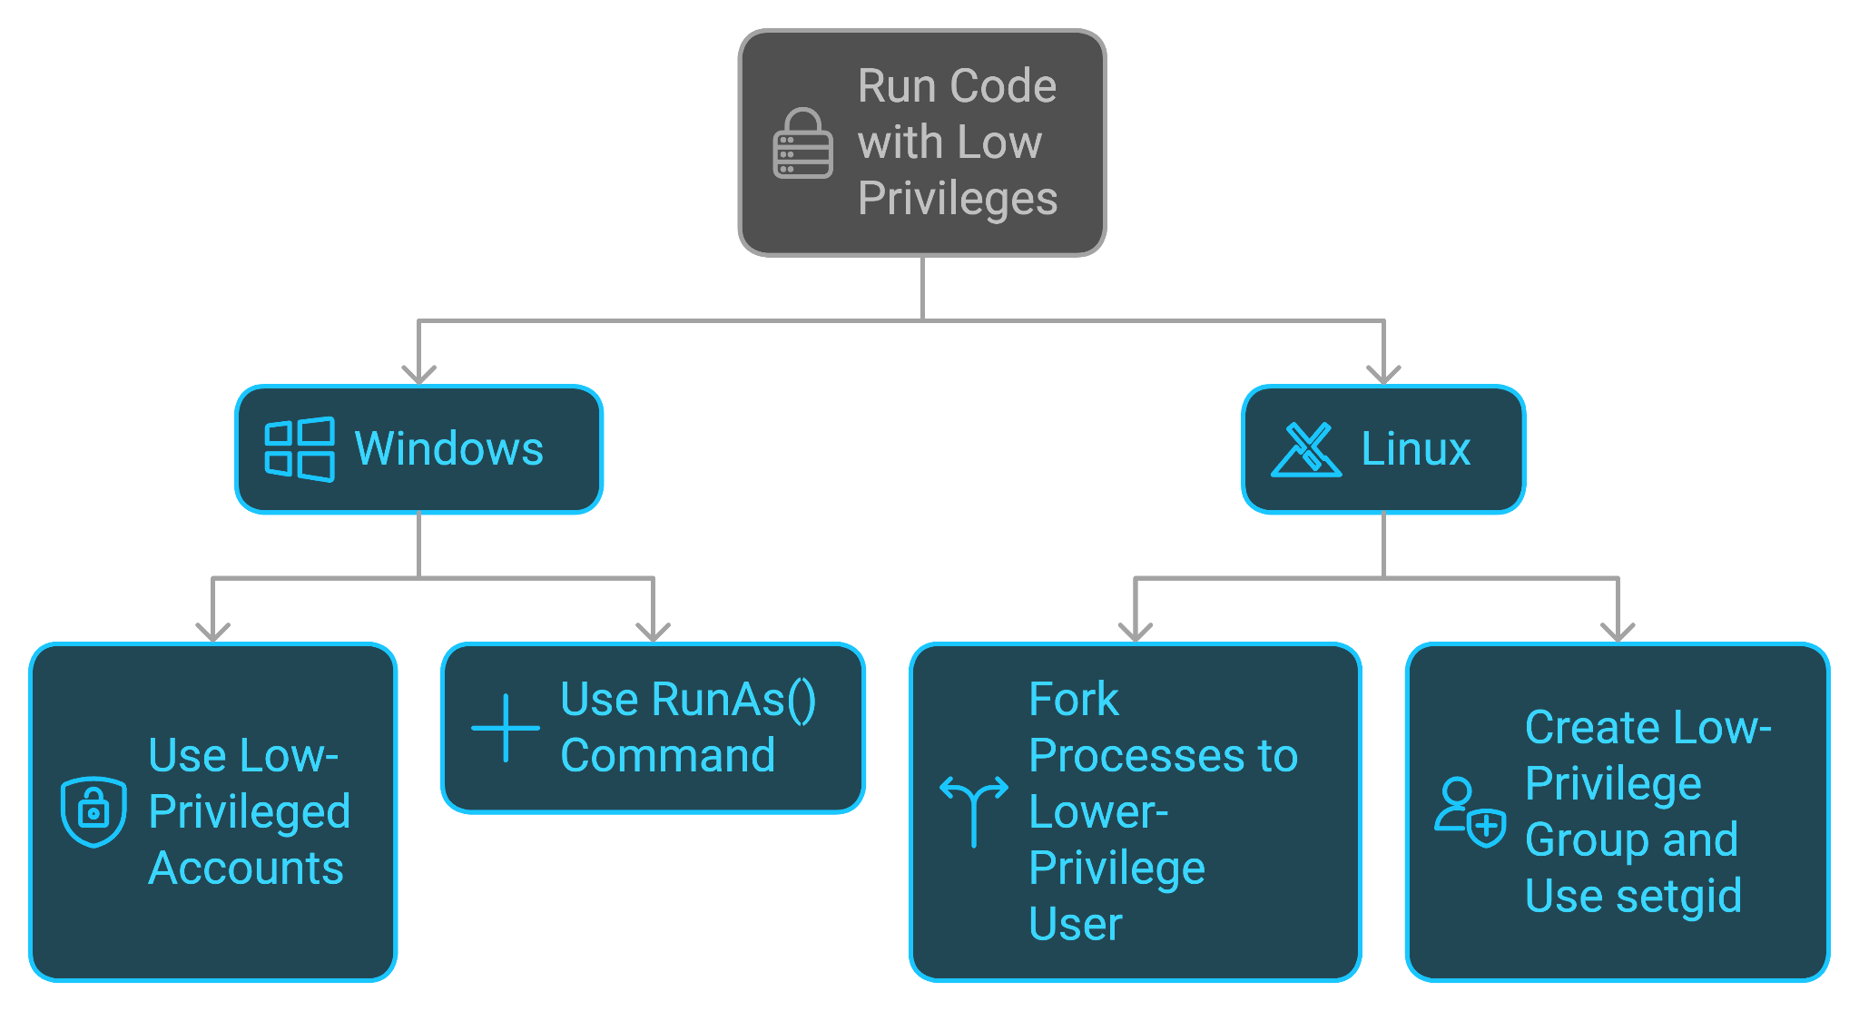
Redemption Steps
Run the code with least privilege possible
Ways to run with low privilege Windows:
Run code with low-privileged accounts
Use the RunAs() command
On Linux, isolate processes by forking them to a lower-privilege user account
On Linux, create a low-privilege group and use setgid to change an application’s group

Slide 59
Redemption Steps (cont.)
If code needs to be run with elevated privileges, only run elevated privileges at that point
This code must be deescalated, especially in cases such as errors
Ensure processes that are run by high-level accounts are not accessible to low-level accounts
Consider the consequences if a low-level user could change startup tasks

Slide 60
What to Take Away
The purpose is to mitigate the potential damaging effects of a program
Don’t give any program more privileges than necessary
Make sure any privilege escalation is appropriately deescalated in any and every circumstance
Do​ | Do not​ | Consider​
Plan for least privilege early in your development cycle​ | Run your code with administrative or root capabilities simply because “it works”​ | Dropping unneeded privileges as soon as possible to reduce exposure​
Run your code with the lowest possible privilege​ | ​Forget to consider to deescalate if a privileged function fails | Using Linux or BSD capabilities​

Slide 61
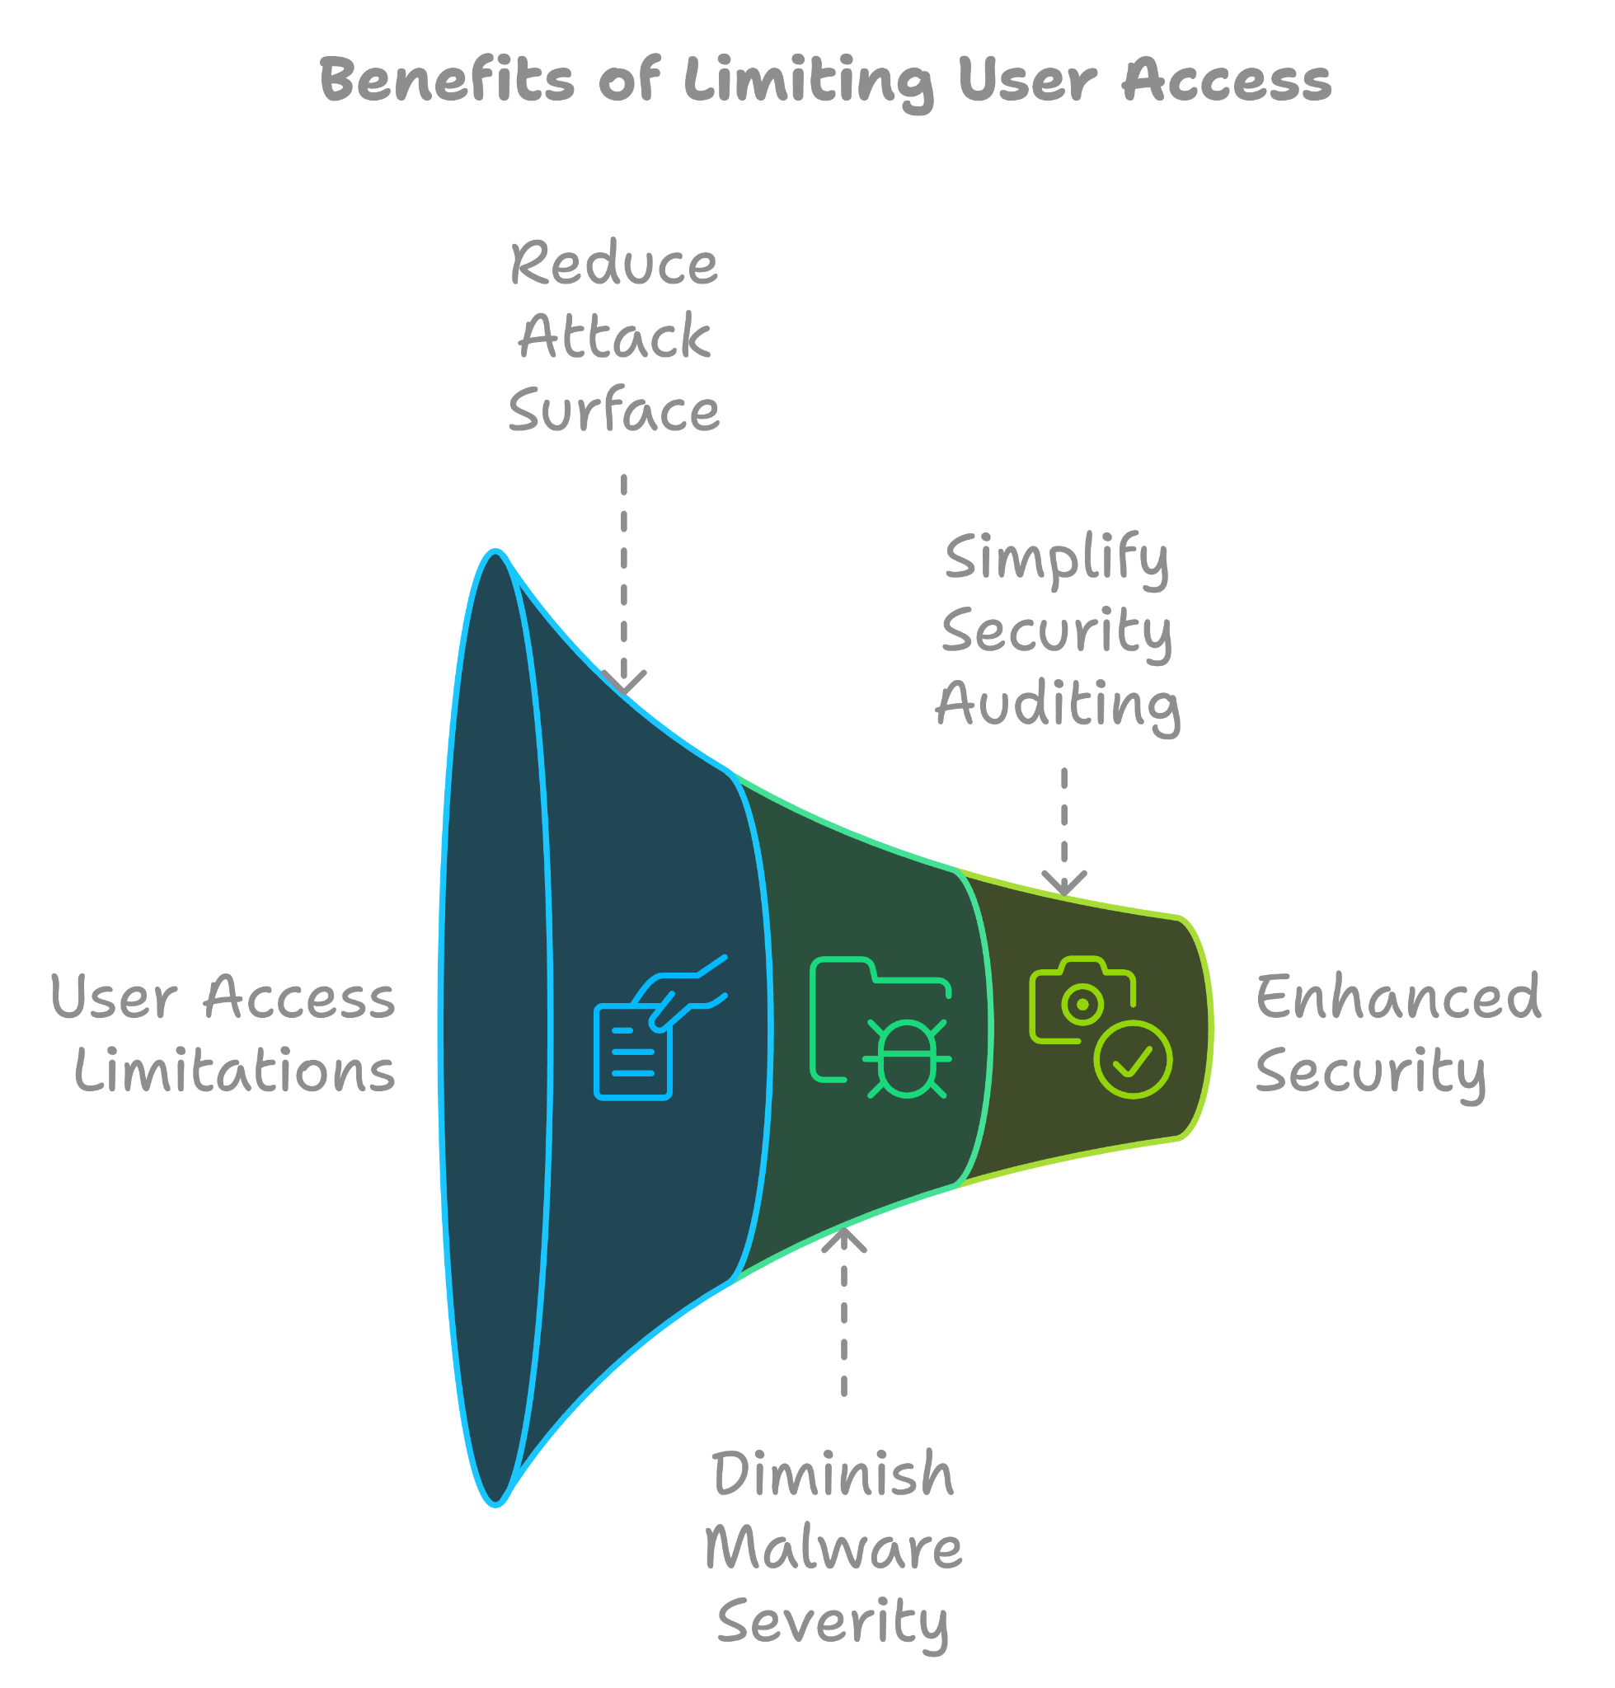
Benefits of Running Code with Limited Privilege
Limits the attack surface to vulnerabilities that are usable by non-admin users, limiting the applications which run and can possibly be exploited
Diminishes the severity of malware that relies on elevated privileges to spread, maintain persistence, and otherwise function
Makes security auditing easier by being able to constrain user activity to secure actions

Slide 62
Python Example (Redemption)
def makeNewUserDir(username): if invalidUsername(username): #avoid CWE-22 and CWE-78 print(Bad username’) return False
try: raisePrivileges() os.mkdir('/home/' + username) lowerPrivileges() except OSError: lowerPrivileges() print('Unable to create directory) return False return True
Apply the Principle of Least Privilege whenever possible
If privileges must be escalated, ensure they are deescalated no matter what
The highlighted portion lowers privileges even on failure
Trace through all routes of code if needed

Slide 63
Python Example (Tracing)
No error
Code runs normally
os.mkdir error?
Privileges de-escalated?
Code Start
Privileges escalated
Code End
‘Except’ case run
Error

Slide 64
Models
The Bell-LaPadula and Biba models serve as ways to implement access control
The Bell-LaPadula model focuses on data confidentiality
Prevent confidential data from being read by unauthorized parties
Higher-level data cannot be leaked to lower-level restrictions
The Biba model instead focuses on data integrity
Prevent data modification by unauthorized parties
Lower-level data cannot corrupt higher-level data

Slide 65
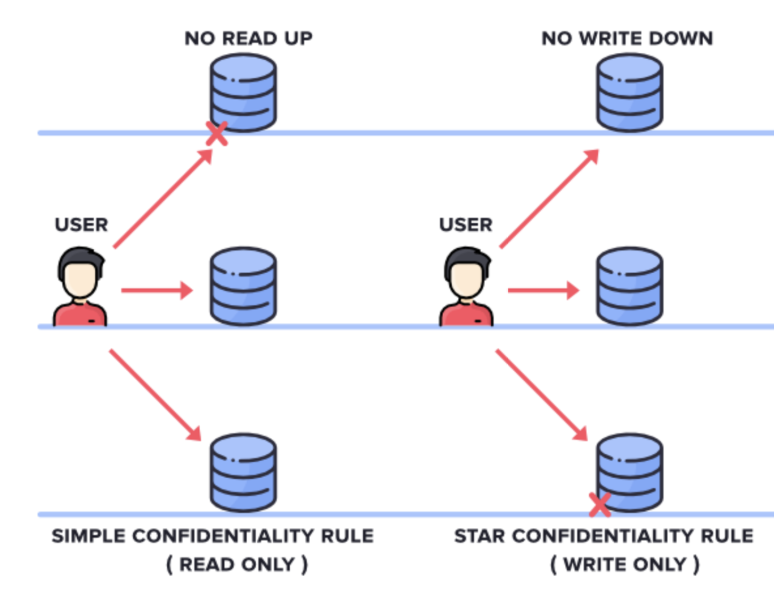
Bell-LaPadula Model
SIMPLE CONFIDENTIALITY RULE: Simple Confidentiality Rule states that the User can only Read the files on the Same Layer of Secrecy and lower, but nothing higher, which we call NO READ-UP
STAR CONFIDENTIALITY RULE: Star Confidentiality Rule states that the User can only Write the files on the Same Layer of Secrecy higher, but nothing lower, which we call NO WRITE-DOWN

Slide 66
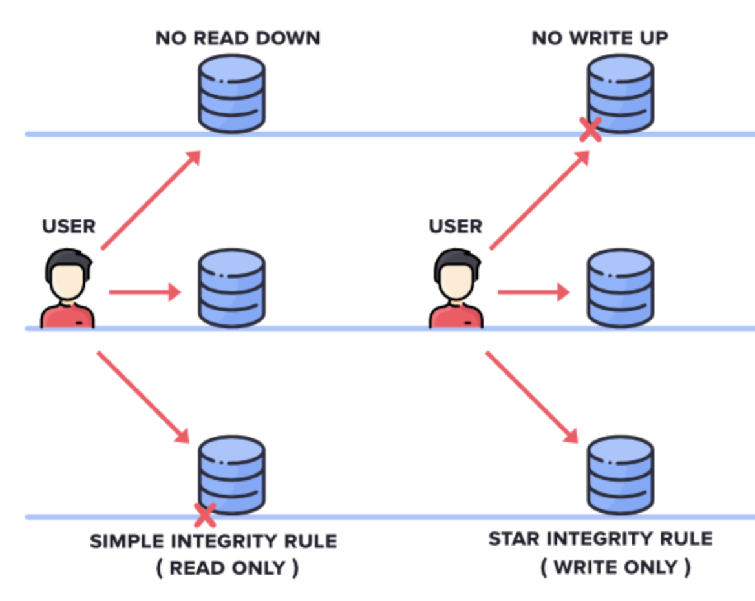
Biba Model
SIMPLE INTEGRITY RULE: Simple Integrity Rule states that the User can only Read the files on the Same Layer of Secrecy and higher but nothing lower, which we call NO READ DOWN
STAR INTEGRITY RULE: Star Integrity Rule states that the User can only Write the files on the Same Layer of Secrecy and lower, but nothing higher, which we call NO WRITE-UP

Slide 67
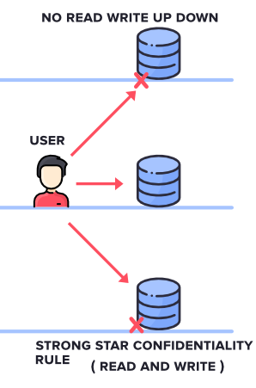
Strong Star Confidentiality
A User can only Read and Write to the files on the Same Layer of Secrecy, but nothing higher or lower
Prevents data sharing between different ranks in any direction
Ensures security at the cost of effective loss of information for parties (not as practical in most cases)

Slide 68
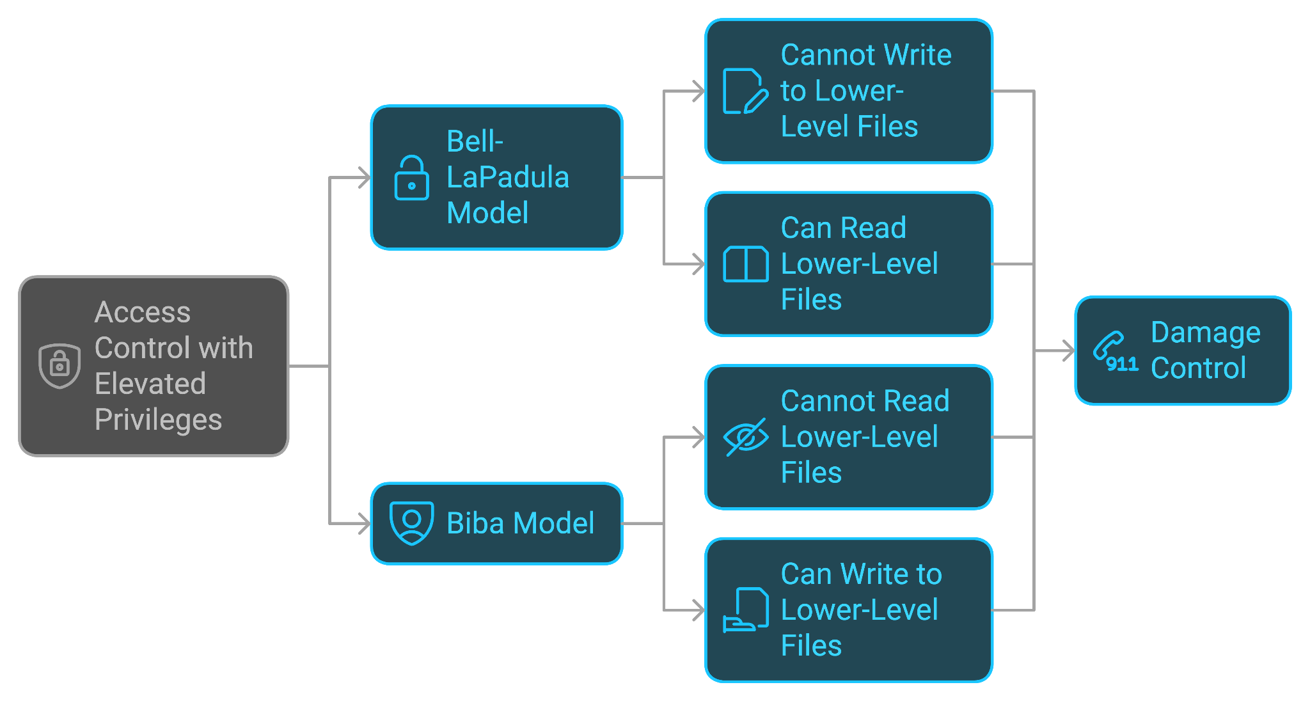
What do the Models Mean?
Consider access control in the scope of elevated privileges
Bell-LaPadula model (data confidential from lower-ranks)
Users with elevated privileges cannot write to lower-level files, only read them
The Biba model (data integrity is secure from lower ranks)
Users with elevated privileges cannot read from lower-level files, only write to them
In the event of elevated privileges being abused, helps restrict what these privileges are able to achieve as a form of damage control

Slide 69
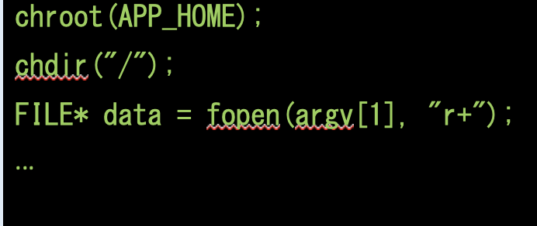
C Example
Chroot() was used to restrict to a subset of the filesystem below APP_HOME to prevent attackers from using the program to gain unauthorized access to other files. This a great start to executing code with least privilege.
What is wrong: there is no call to setuid() with a non-zero value so it will continue to operate with root permissions.

Slide 70
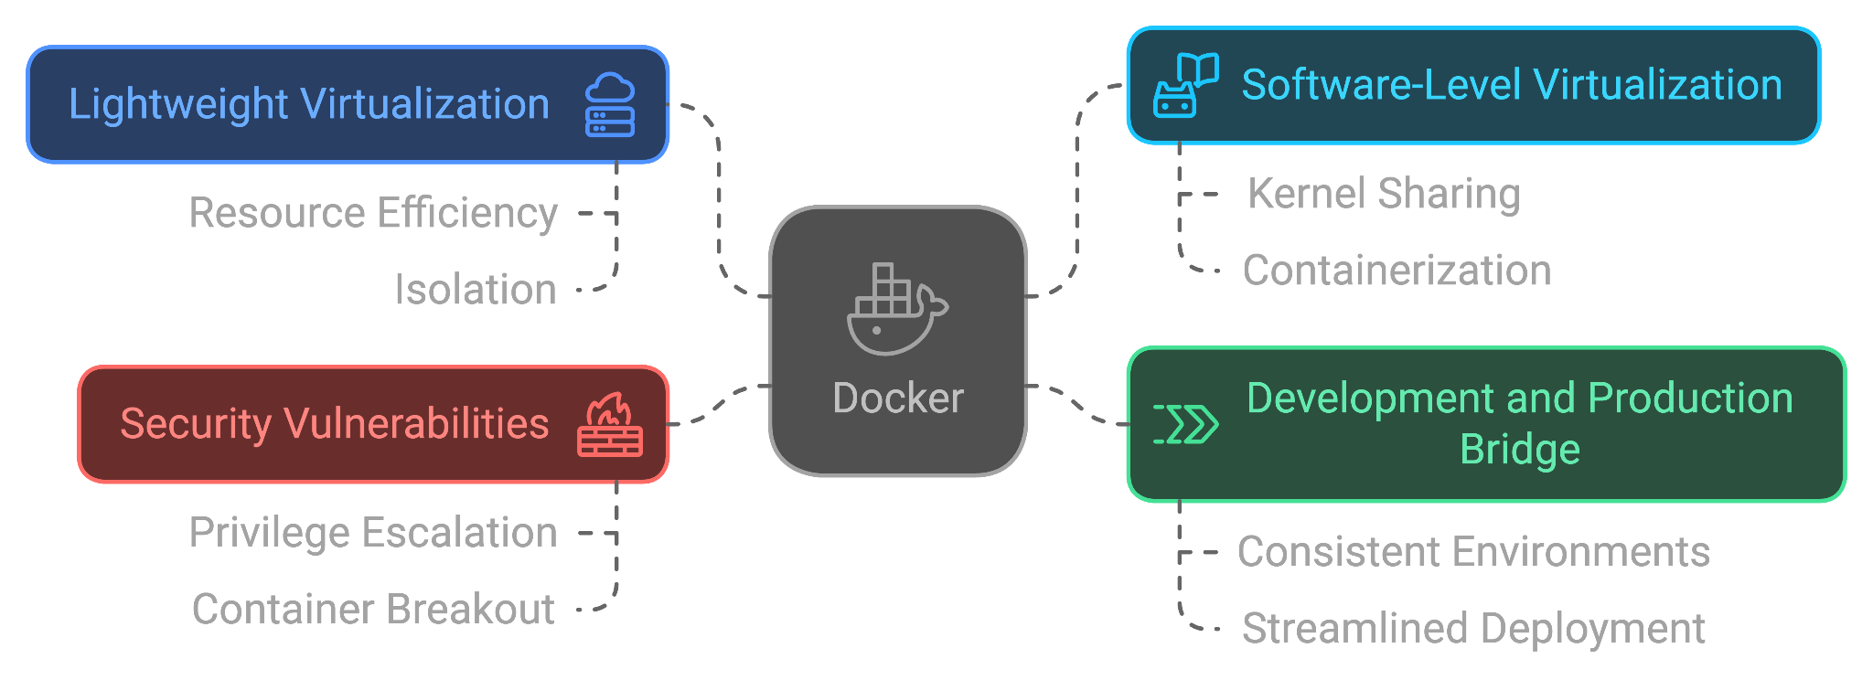
Docker
Similar to Virtual Machines (VMs) as a way to contain and organize software from the host OS, though more lightweight
Runs using and virtualizes at a software-level
Serves as a bridge between production and development servers for programming
Vulnerable to privilege escalation

Slide 71
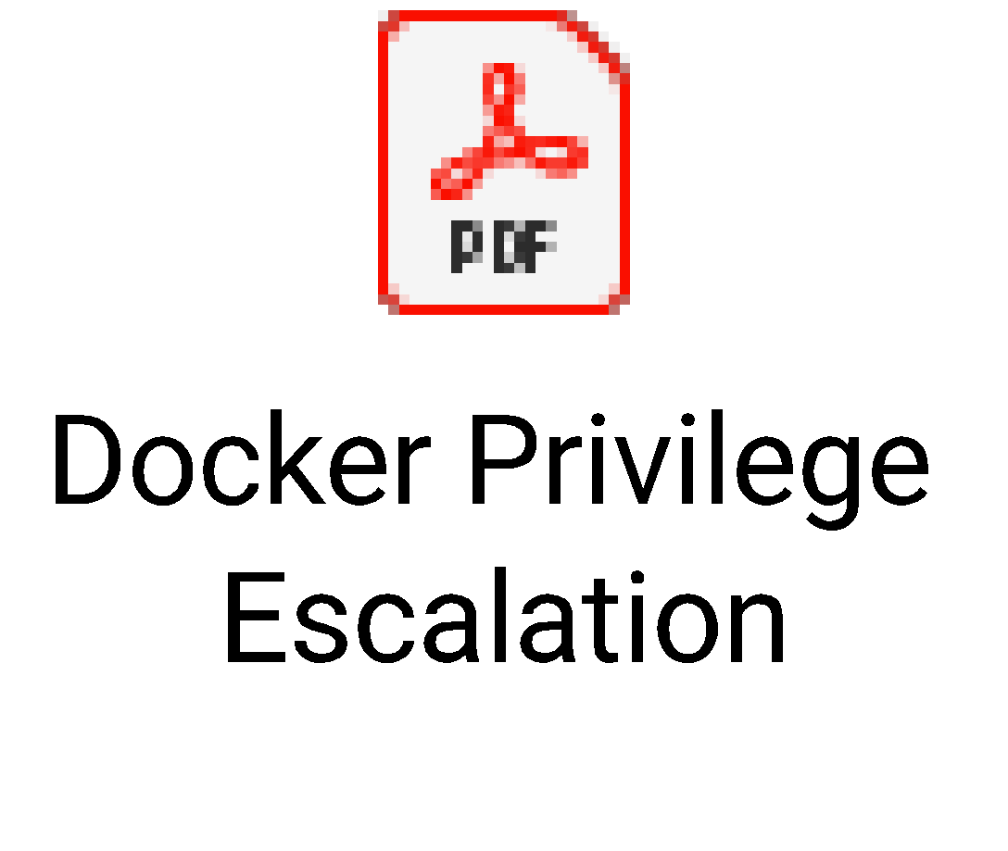
Docker Privilege Escalation
By default, each container is run as root
Members of ‘docker’ group can concatenate a root user made in the container to /etc/passwd
Mitigated primarily by applying Principle of Least Privilege and have Docker not launch using a root account
See attached PDF presentation for further reading as well as https://flast101.github.io/docker-privesc/

Slide 72
Real-Life Examples
Adobe Acrobat and Reader had a security bypass vulnerability which could lead to privilege escalation due to improper privilege management.
https://nvd.nist.gov/vuln/detail/CVE-2018-19725
Windows promptless User Account Control Bypass – not explicitly escalation, but allows the UAC prompt (that confirms you want to run something with elevated privileges) to be bypassed
https://www.youtube.com/watch?v=C9GfMfFjhYI

Slide 73
Real-Life Examples (cont.)
Older versions of Windows ran the screensaver as SYSTEM – Overwriting the default executable would allow code to be executed with admin privileges
https://blogs.msmvps.com/donna/2004/11/24/microsoft-windows-logon-screensaver-local-privilege-escalation-vulnerability/
https://attack.mitre.org/techniques/T1546/002/
Drupal had a vulnerability where users could post approved comments (without their account having the ability to post approved comments) by using a REST API with improper privilege management.
https://nvd.nist.gov/vuln/detail/CVE-2017-6924

Slide 74
Vim SetUID() Example
First, search for files with the setuid() bit -- find / -user root –perm -4000 –print 2>/dev/null
If Vim is listed here, it inherits root permissions when run. Open a root bash shell and launch vim. Then set the following within the bash shell:
:set shell=/bin/sh
:shell
This will give an interactive shell that can then be upgraded to Bash with: bash –p
This kind of privilege escalation can take place using Less, Find, or Nmap as well.

Slide 75
Mobile Permissions
Mobile applications have reduced granularity of access control compared to PC Operating Systems.
This means that developers need to be very selective in only asking for permissions their application needs to avoid forcing users to run code with elevated permissions.
As a user, it is important to understand what permissions apps are requesting, and which permissions those apps need to run successfully.
Why would a flashlight application need access to your microphone and location?

Slide 76
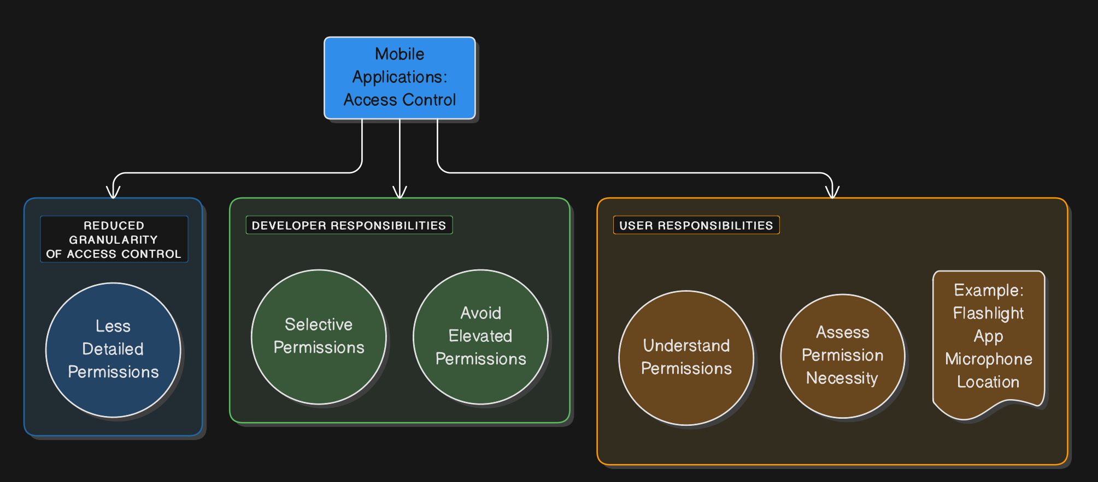
Mobile Permissions

Slide 77
Mobile Permissions Mitigations
On many Android phones, users can filter apps by permission to see a list of apps that use each permission.
For instance, to see what applications have access to a user’s microphone in Android 10, users can go to “Settings -> Privacy -> Permission manager -> Microphone” and will be able to see a clear list of apps with this permission.
iOS 13 and 14 have allowed users to select which permissions an app has access to and whether the app should consistent or one-time access.
Apple runs all iOS apps in a sandboxed environment.
Users should verify each applications permission to ensure no applications are running with unnecessary permissions. This will limit their possible attack surface by managing permission well.

Slide 78
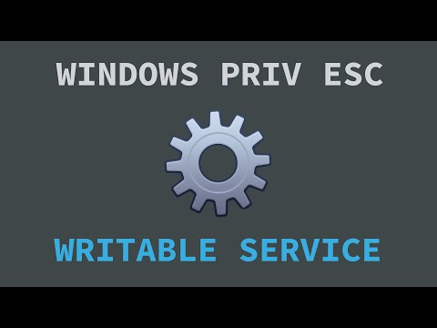
Penetration Testing & Privilege Escalation
Windows privilege escalation example as a privileged user is running a service that can be overwritten by a low-level user

Slide 79
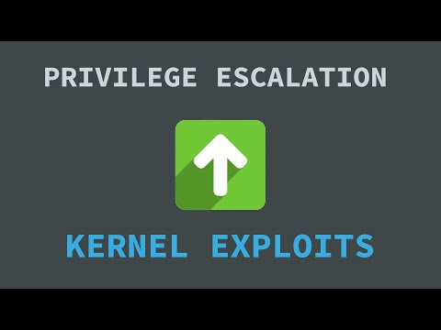
Kernel Exploits (Linux OS)
Ubuntu privilege escalation example using a known kernel exploit compiled and run by a regular user to obtain root access

Slide 80
References (AJR)
1. Saltzer, J. H., & Schroeder, M. D. (1975). The Protection of Information in Computer Systems. Proceedings of the IEEE, 63(9), 1278-1308. https://doi.org/10.1109/PROC.1975.9939
2. Howard, M., LeBlanc, D., & Viega, J. (2010). 24 Deadly Sins of Software Security: Programming Flaws and How to Fix Them. McGraw-Hill.
3. Martello Security. (n.d.). Common Weakness Enumeration (CWE) - CWE-250: Execution with Unnecessary Privileges. https://www.martellosecurity.com/kb/mitre/cwe/250/
4. F5 Networks. (2021). What Is the Principle of Least Privilege and Why Is It Important? F5 Labs. https://www.f5.com/labs/articles/education/what-is-the-principle-of-least-privilege-and-why-is-it-important
5. Netwrix. (2018). What is Privilege Escalation? Netwrix Blog. https://blog.netwrix.com/2018/09/05/what-is-privilege-escalation/
6. Brink, S. (2018). See If Process is Running as Administrator (Elevated) in Windows 10. Windows TenForums.com. https://www.tenforums.com/tutorials/26850-see-if-process-running-administrator-elevated-windows-10-a.html
7. Rouse, M. (n.d.). What is Principle of Least Privilege (POLP)? SearchSecurity. https://searchsecurity.techtarget.com/definition/principle-of-least-privilege-POLP
8. Shibli, M. (2019). Linux Privilege Escalation Exploiting Sudo Rights - Part I. Medium. https://medium.com/schkn/linux-privilege-escalation-using-text-editors-and-files-part-1-a8373396708d
9. Apple Inc. (n.d.). About App Sandbox. Apple Developer Documentation. https://developer.apple.com/library/archive/documentation/Security/Conceptual/AppSandboxDesignGuide/AboutAppSandbox/AboutAppSandbox.html
10. GeeksforGeeks. (n.d.). Introduction to Classic Security Models. https://www.geeksforgeeks.org/introduction-to-classic-security-models/

Slide 81
References
https://cwe.mitre.org/data/definitions/269
https://en.wikipedia.org/wiki/Privilege_escalation
https://en.wikipedia.org/wiki/Docker_(software)
Ray Steen’s Docker Privilege Escalation Presentation (linked)
https://flast101.github.io/docker-privesc/

Slide 82
References (Maintained from Previous)
https://www.martellosecurity.com/kb/mitre/cwe/250/
https://www.f5.com/labs/articles/education/what-is-the-principle-of-least-privilege-and-why-is-it-important
https://www.f5.com/labs/search?q=access+control
https://blog.netwrix.com/2018/09/05/what-is-privilege-escalation/
https://cwe.mitre.org/data/definitions/250.html
Brink, Shawn. “See if Process is Running as Administrator (elevated) in Windows 10”, Windows TenForums.com. 29 September 2018, https://www.tenforums.com/tutorials/26850-see-if-process-running-administrator-elevated-windows-10-a.html
Freeland, John. Executing Code with too Much Privilege. 2018.PowerPoint Presentation.
Howard, Michael, et al. 24 Deadly Sins of Software Security: Programming Flaws and How to Fix Them. McGraw-Hill, 2010.
Rouse, Margaret, et al. “What Is Principle of Least Privilege (POLP)? - Definition from WhatIs.com.” SearchSecurity, https://searchsecurity.techtarget.com/definition/principle-of-least-privilege-POLP.
Shibli, Mohd. “Linux Privilege Escalation Exploiting Sudo Rights - Part I.” Medium, Devconnected - DevOps, Sysadmins & Engineering, 11 June 2019, https://medium.com/schkn/linux-privilege-escalation-using-text-editors-and-files-part-1-a8373396708d.
“Vim.” Penetration Testing Lab, 25 Sept. 2017, https://pentestlab.blog/tag/vim/.
https://hypertrack.com/blog/2020/06/24/impact-of-ios13-ios14-location-permissions-on-background-location-access/
https://developer.apple.com/library/archive/documentation/Security/Conceptual/AppSandboxDesignGuide/AboutAppSandbox/AboutAppSandbox.html
https://www.geeksforgeeks.org/introduction-to-classic-security-models/

